Slide 1


Slide 2


Slide 3


Slide 4


Slide 5


Slide 6
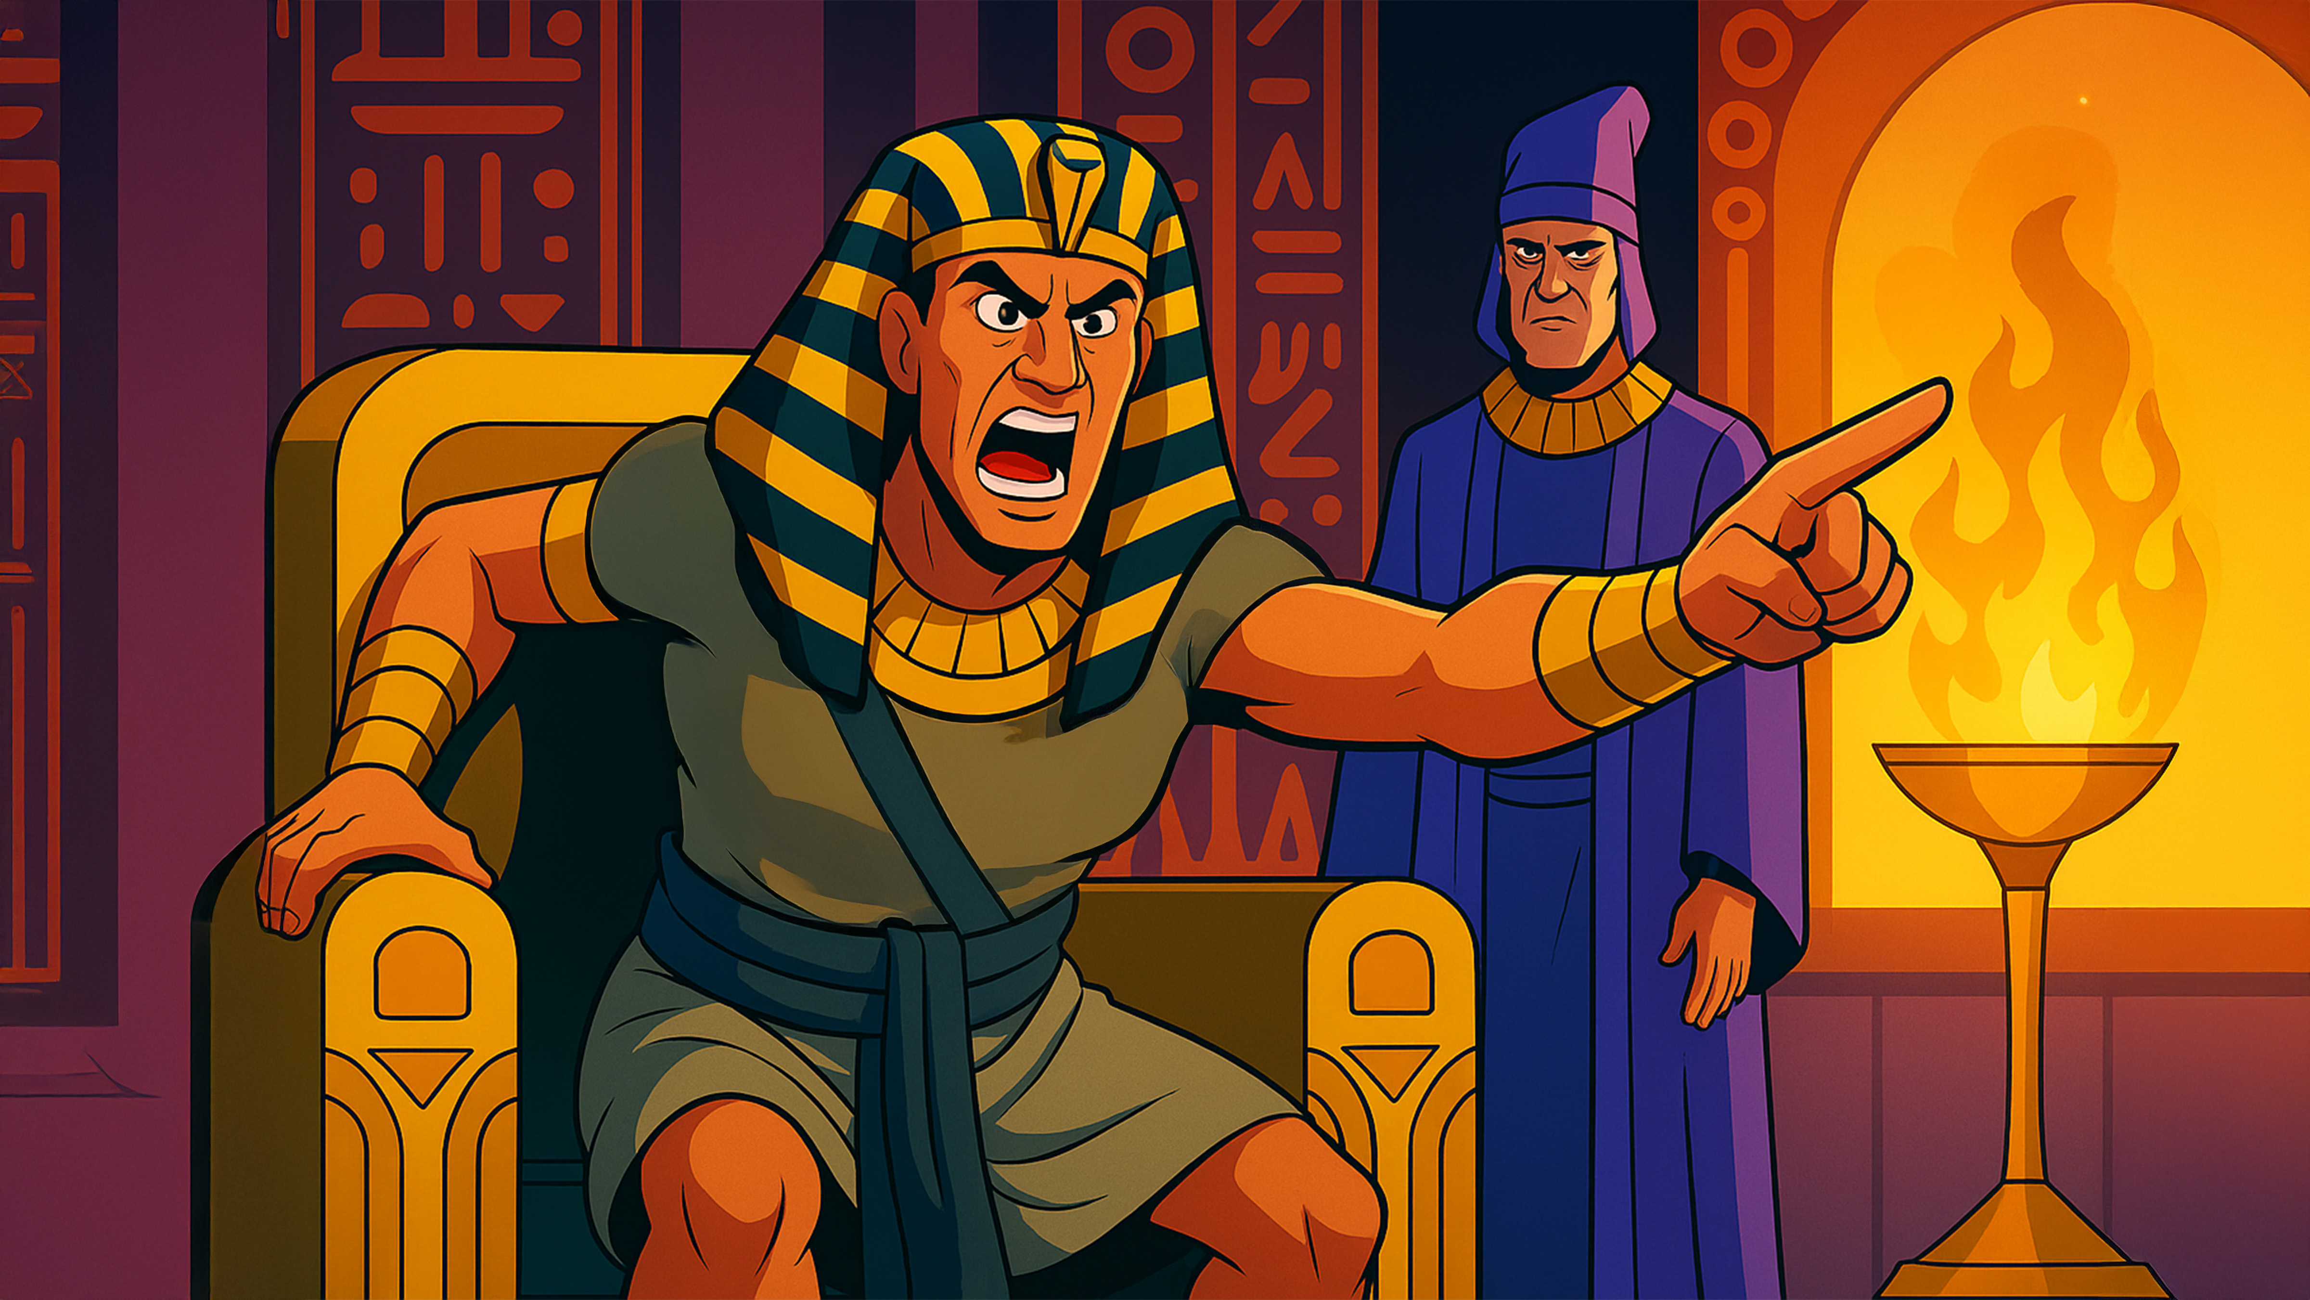

Slide 7
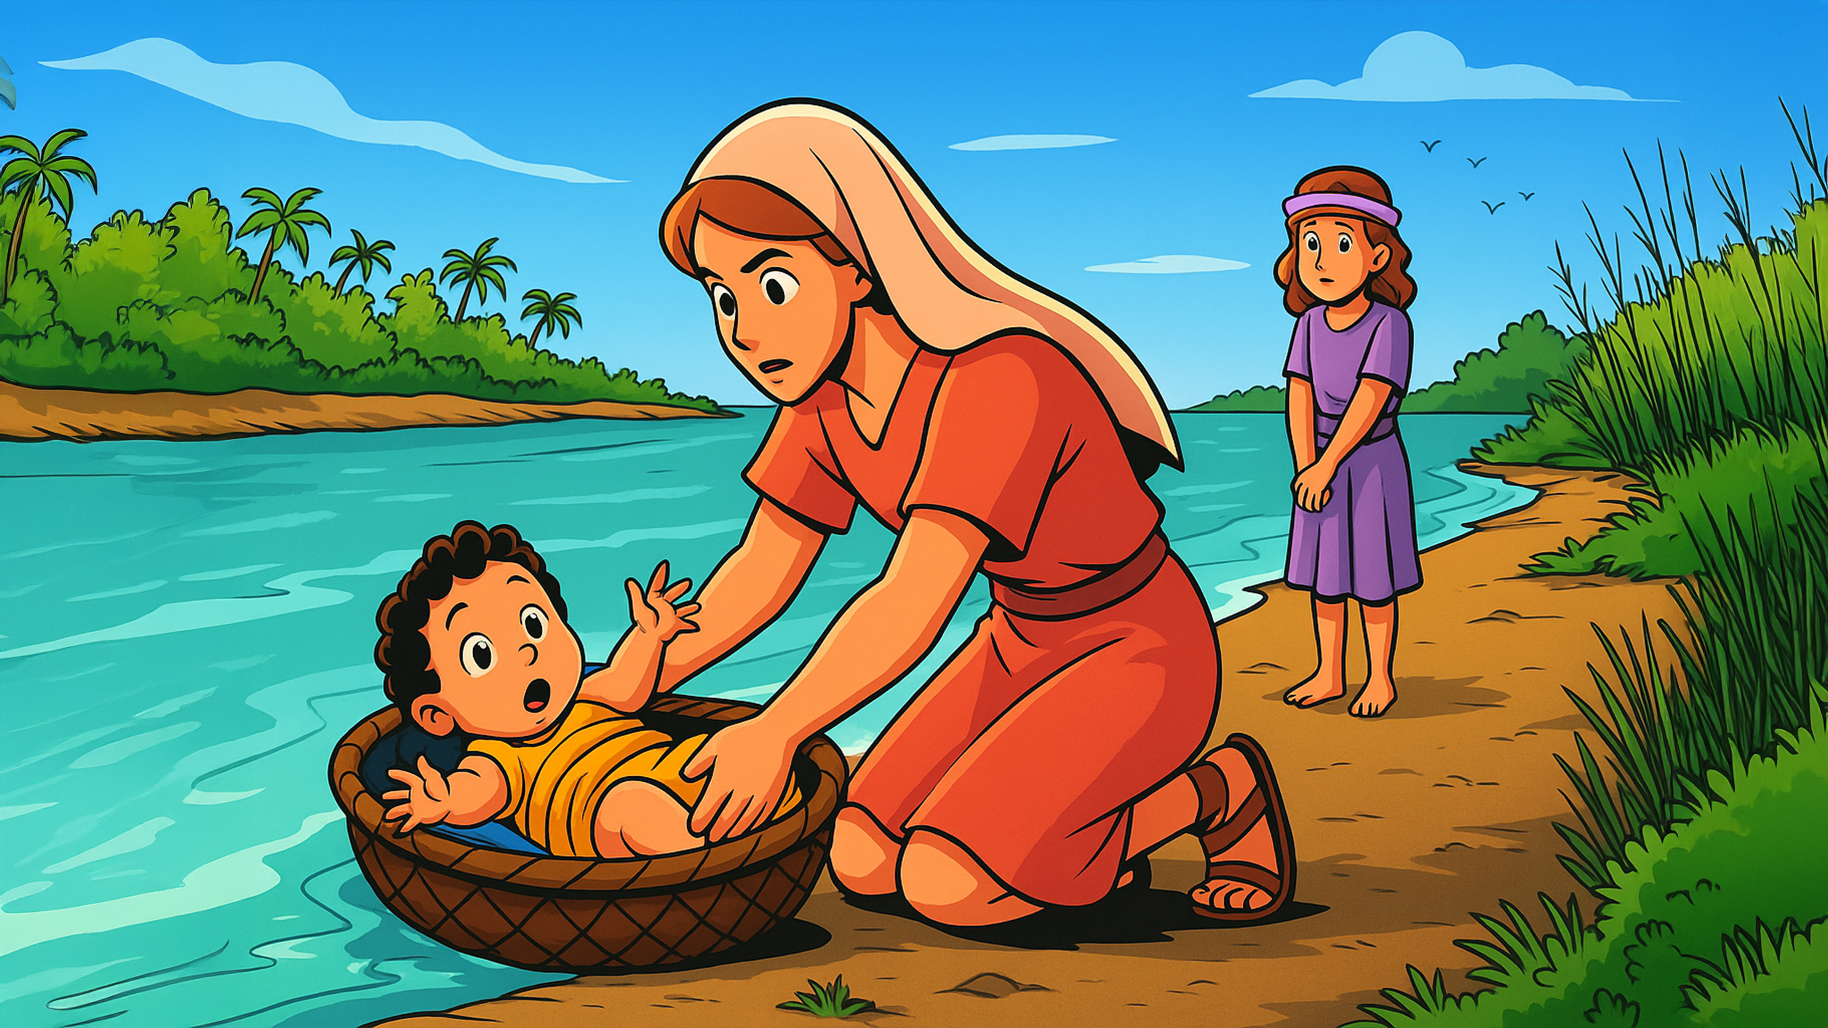

Slide 8
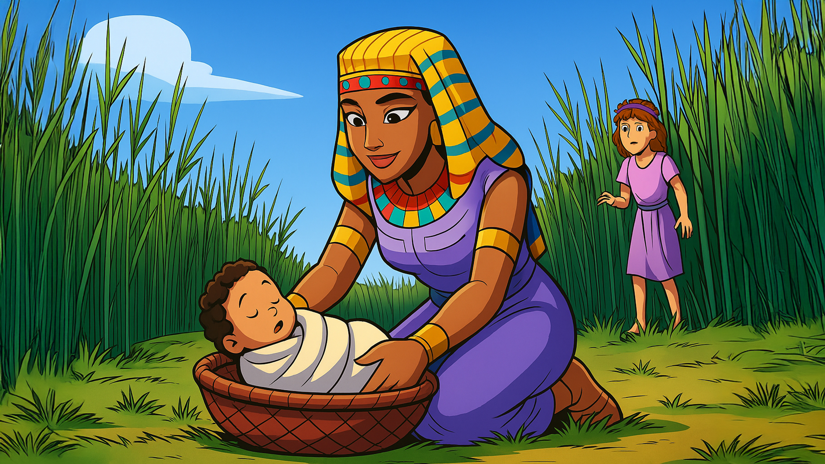

Slide 9
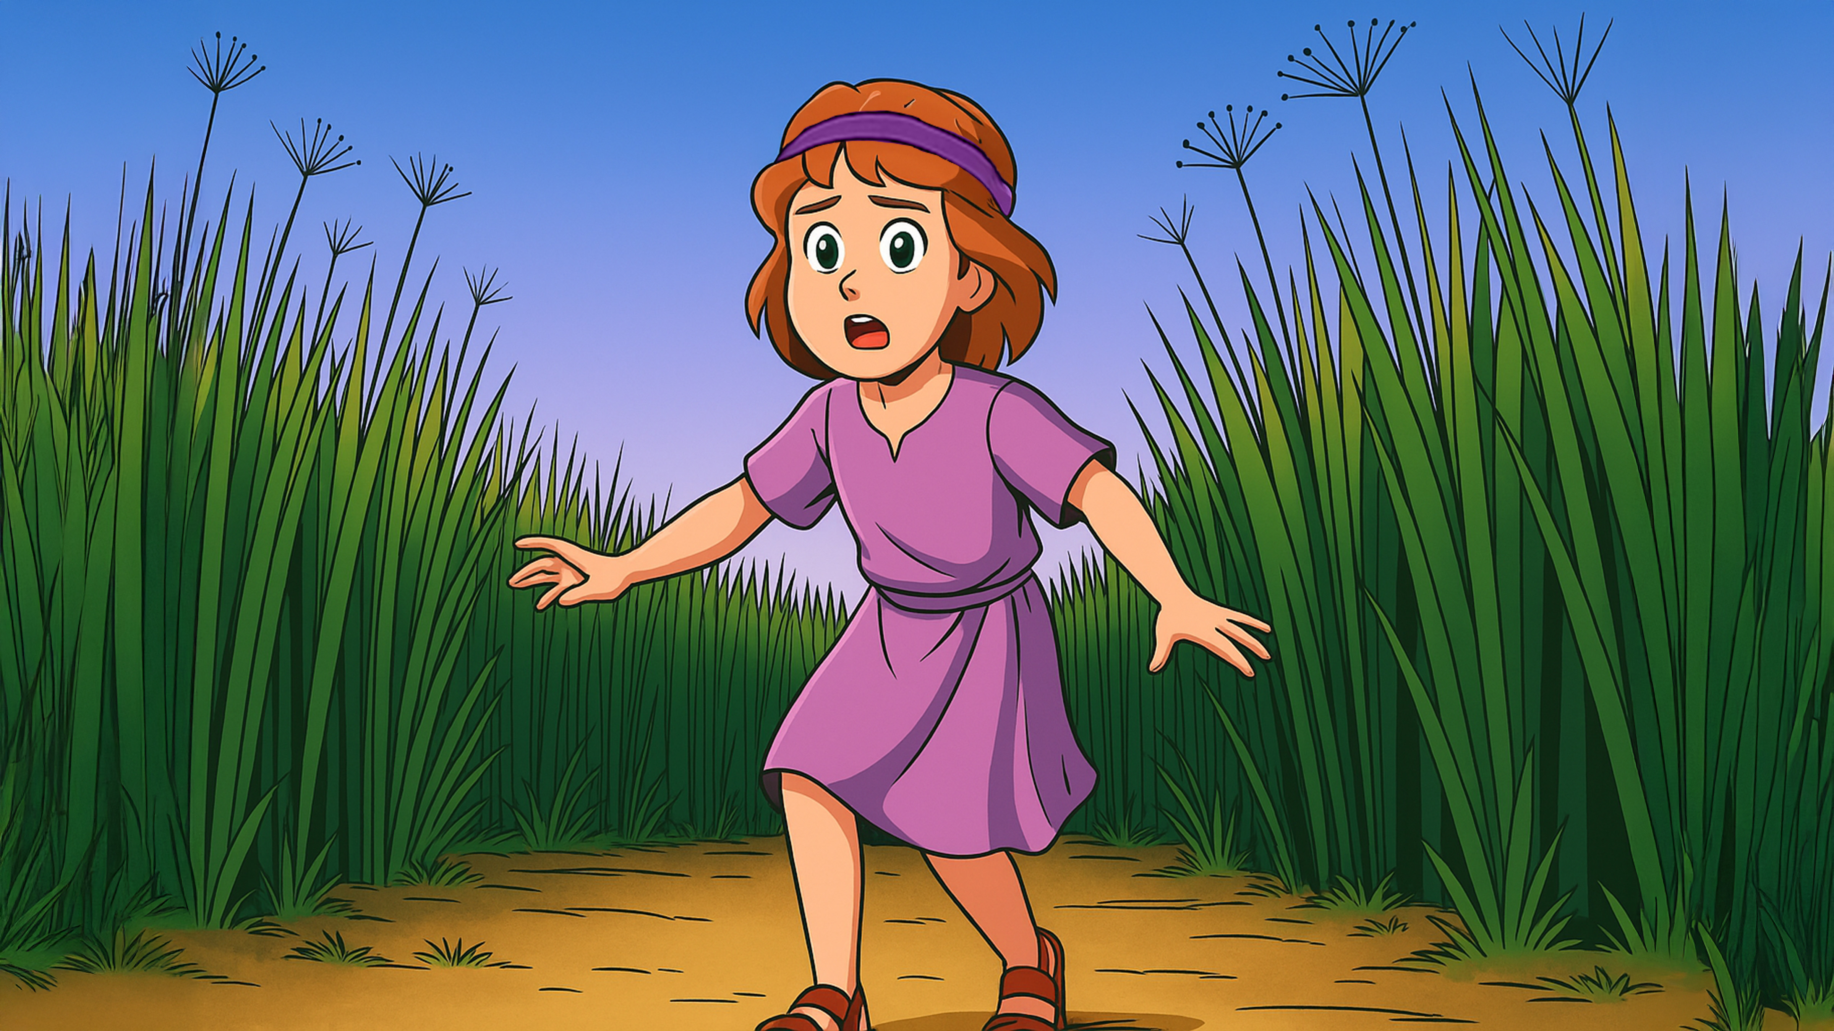

Slide 10
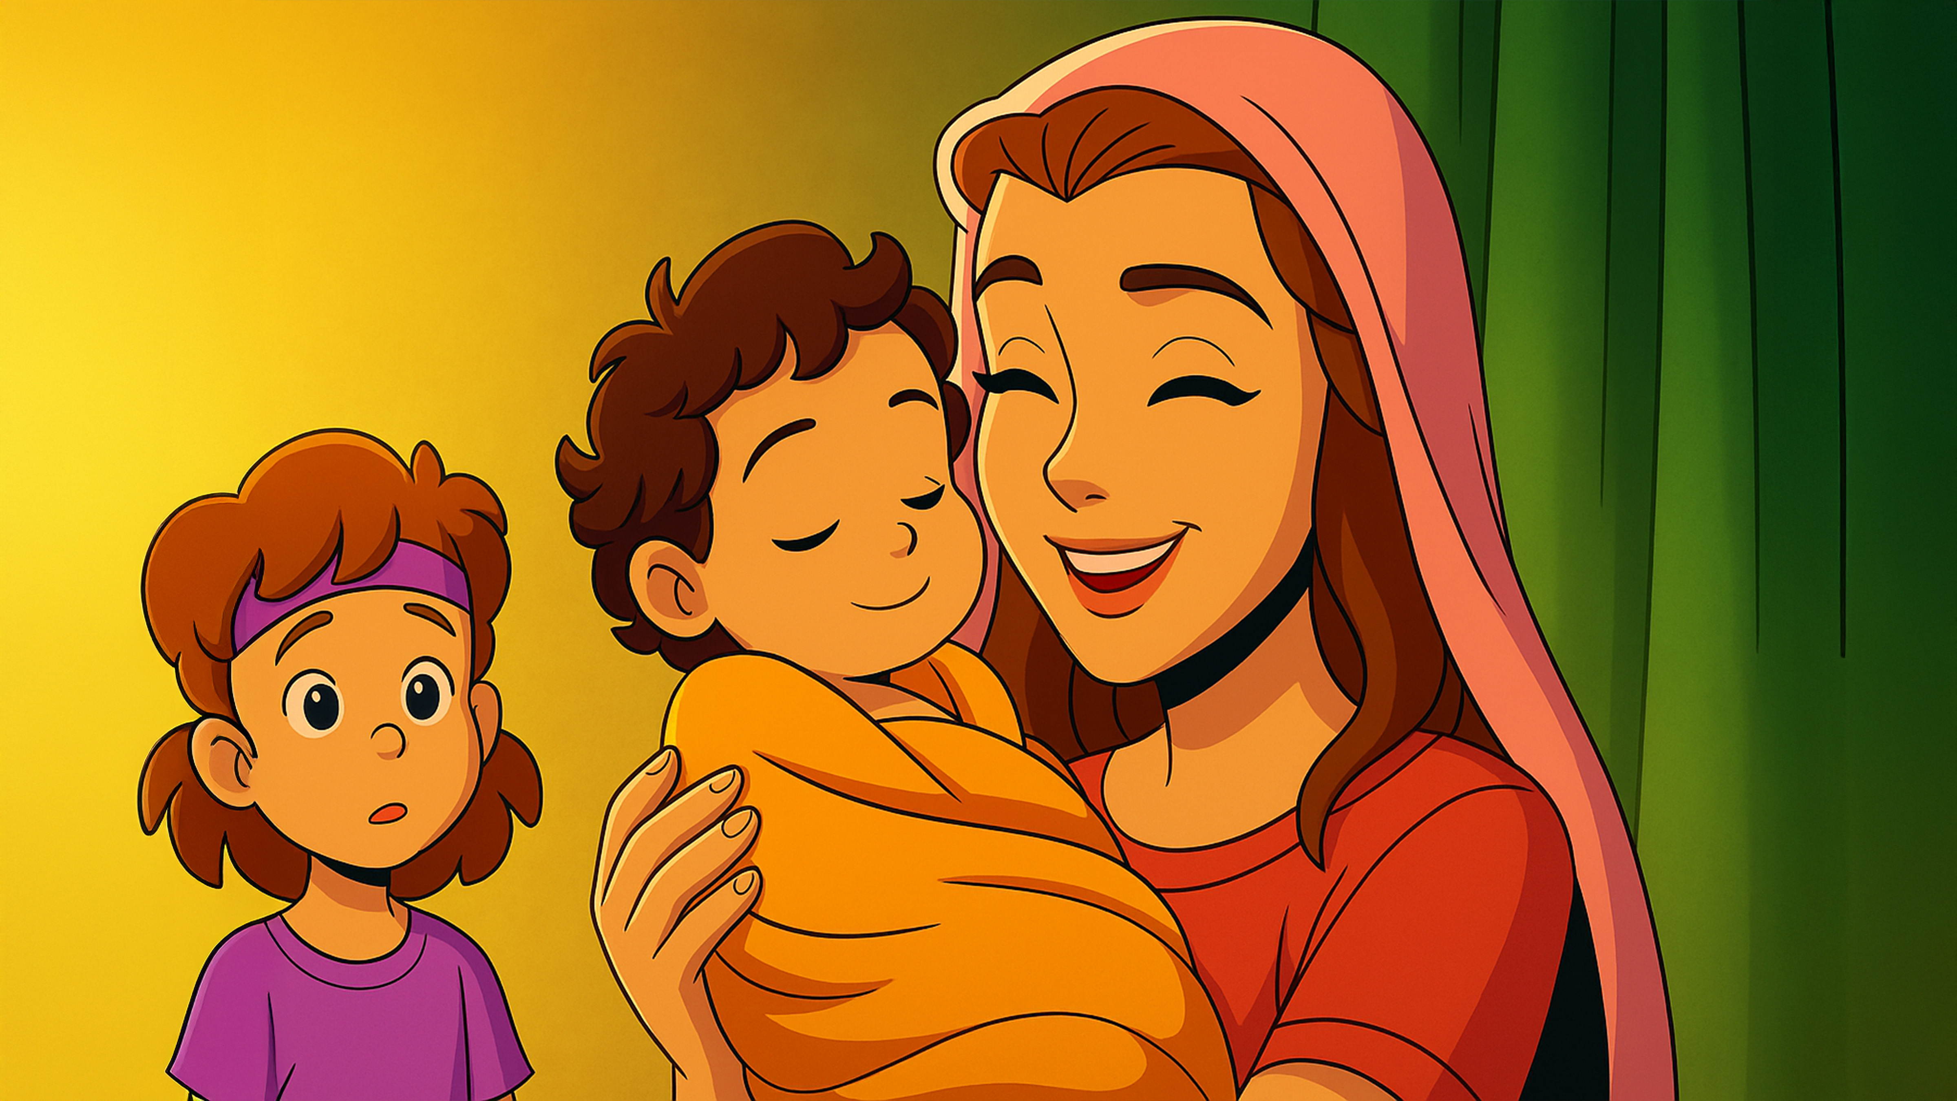

Slide 11
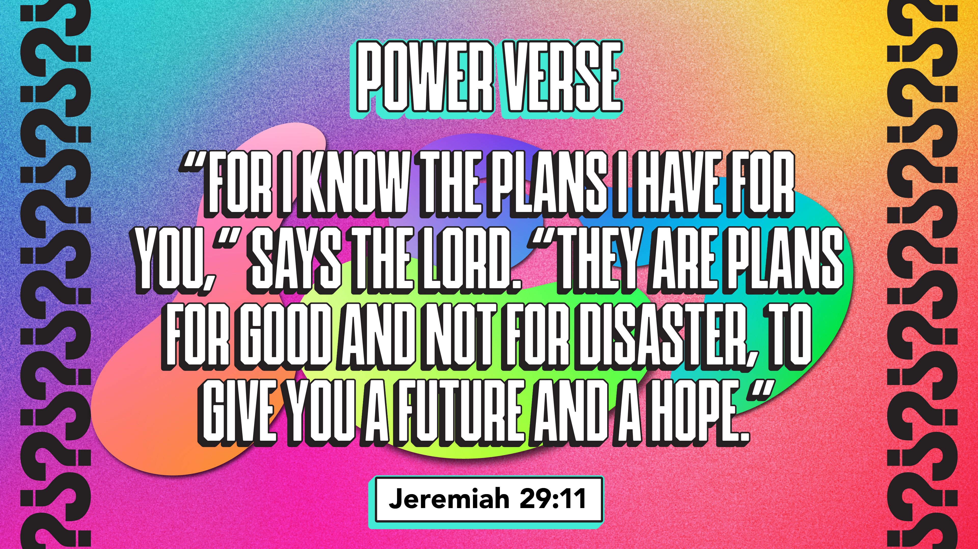

Slide 12


Slide 13


Slide 14


Slide 15


Slide 16


Slide 17


Slide 18

1. Whatchagaddaknow,
today?
* “My Plans Are Good!”
* “God Has A Wonderful
Plan For Me!”
* “I Have A Plan!”

Slide 19
1. Whatchagaddaknow,
today?
ANSWER:
“God Has A Wonderful
Plan For Me!”

Slide 20
2. What person from the Bible
are we learning about in this
series?
* Matthew
* Moses
* Martha

Slide 21
2. What person from the Bible
are we learning about in this
series?
ANSWER:
Moses

Slide 22
3. What did Pharaoh order to
be done with the Hebrew
baby boys?
* They Had To Be Killed
* They Needed Hugs
* They Had To Work

Slide 23
3. What did Pharaoh order to
be done with the Hebrew
baby boys?
ANSWER:
They Had To Be Killed

Slide 24
4. What did Moses’ mom place
him in before she placed
him in the Nile River?
* A Blanket
* A Burger
* A Basket

Slide 25
4. What did Moses’ mom place
him in before she placed
him in the Nile River?
ANSWER:
A Basket

Slide 26
5. Who ended up finding Moses
in the basket?
* Pharaoh
* Pharaoh’s Daughter
* Moses’ Sister

Slide 27
5. Who ended up finding Moses
in the basket?
ANSWER:
Pharaoh’s Daughter

Slide 28
6. Who did Pharaoh’s daughter
choose to be Moses’
caregiver?
* Her Dad
* Moses’ Mom
* Moses’ Sister

Slide 29
6. Who did Pharaoh’s daughter
choose to be Moses’
caregiver?
ANSWER:
Moses’ Mom

Slide 30
7. According to our lesson
today, “God Has A ________
For You.”
* Plan
* Hope
* Purpose

Slide 31
7. According to our lesson
today, “God Has A ________
For You.”
ANSWER:
Plan

Slide 32
8. According to our lesson
today, “God Is _________ You.”
* Holding
* Helping
* Protecting

Slide 33
8. According to our lesson
today, “God Is _________ You.”
ANSWER:
Protecting

Slide 34
9. According to our lesson
today, “God Is Placing You
Right Where He _________
You.”
* Placed
* Wants
* Needs

Slide 35
9. According to our lesson
today, “God Is Placing You
Right Where He _________
You.”
ANSWER:
Wants

Slide 36
10. Where was our Power
Verse found?
* Jeremiah 29:11
* Moses 1:19
* Jonah 2:1

Slide 37
10. Where was our Power
Verse found?
ANSWER:
Jeremiah 29:11

