Slide 1


Slide 2


Slide 3


Slide 4
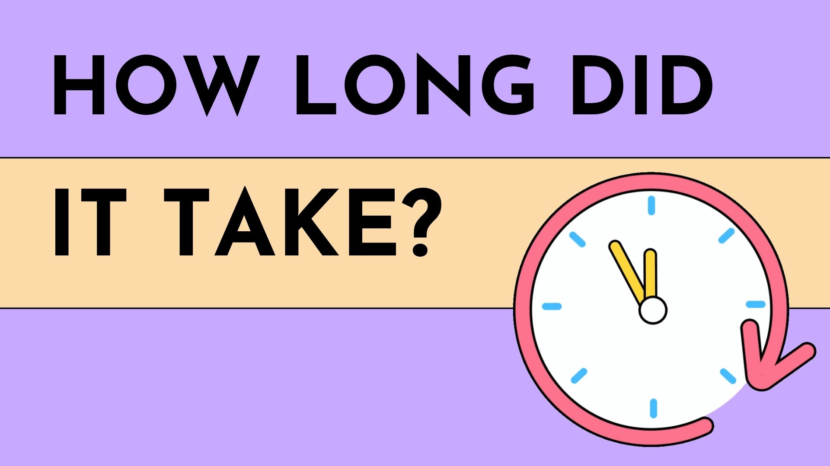

Slide 5
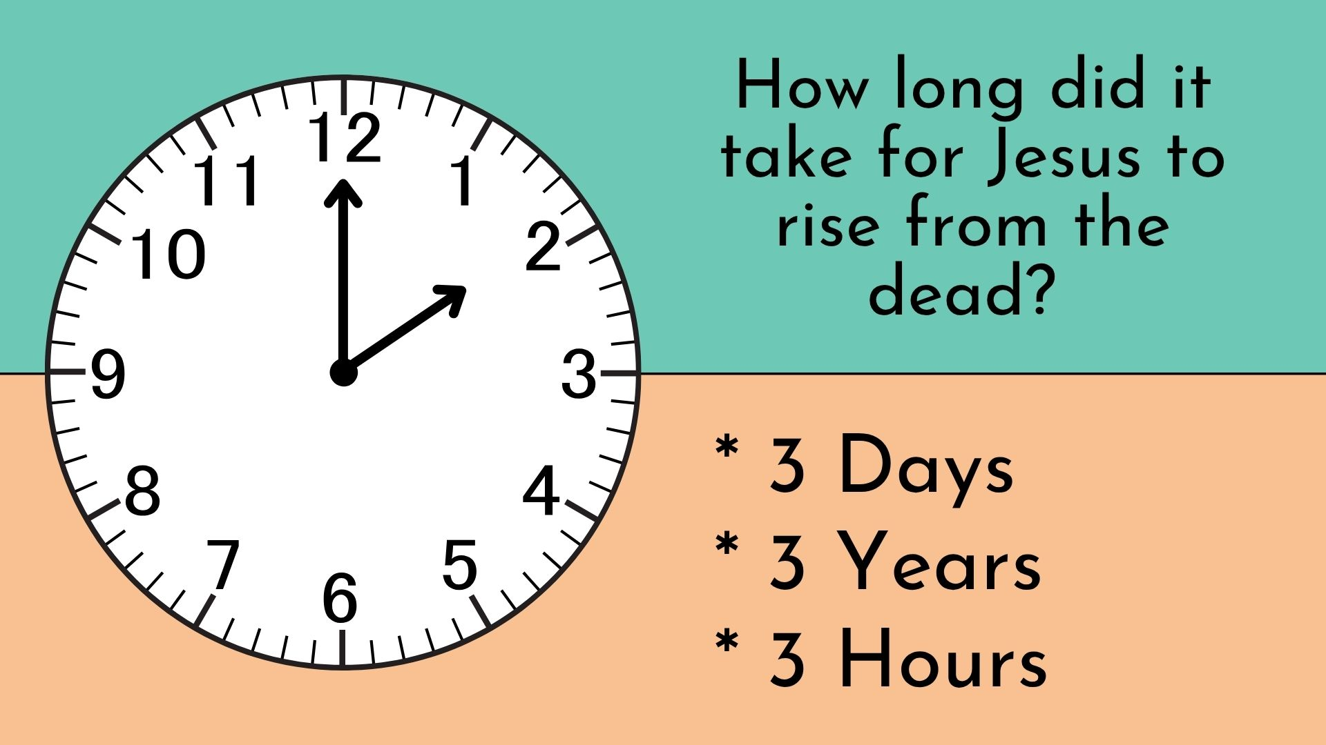

Slide 6
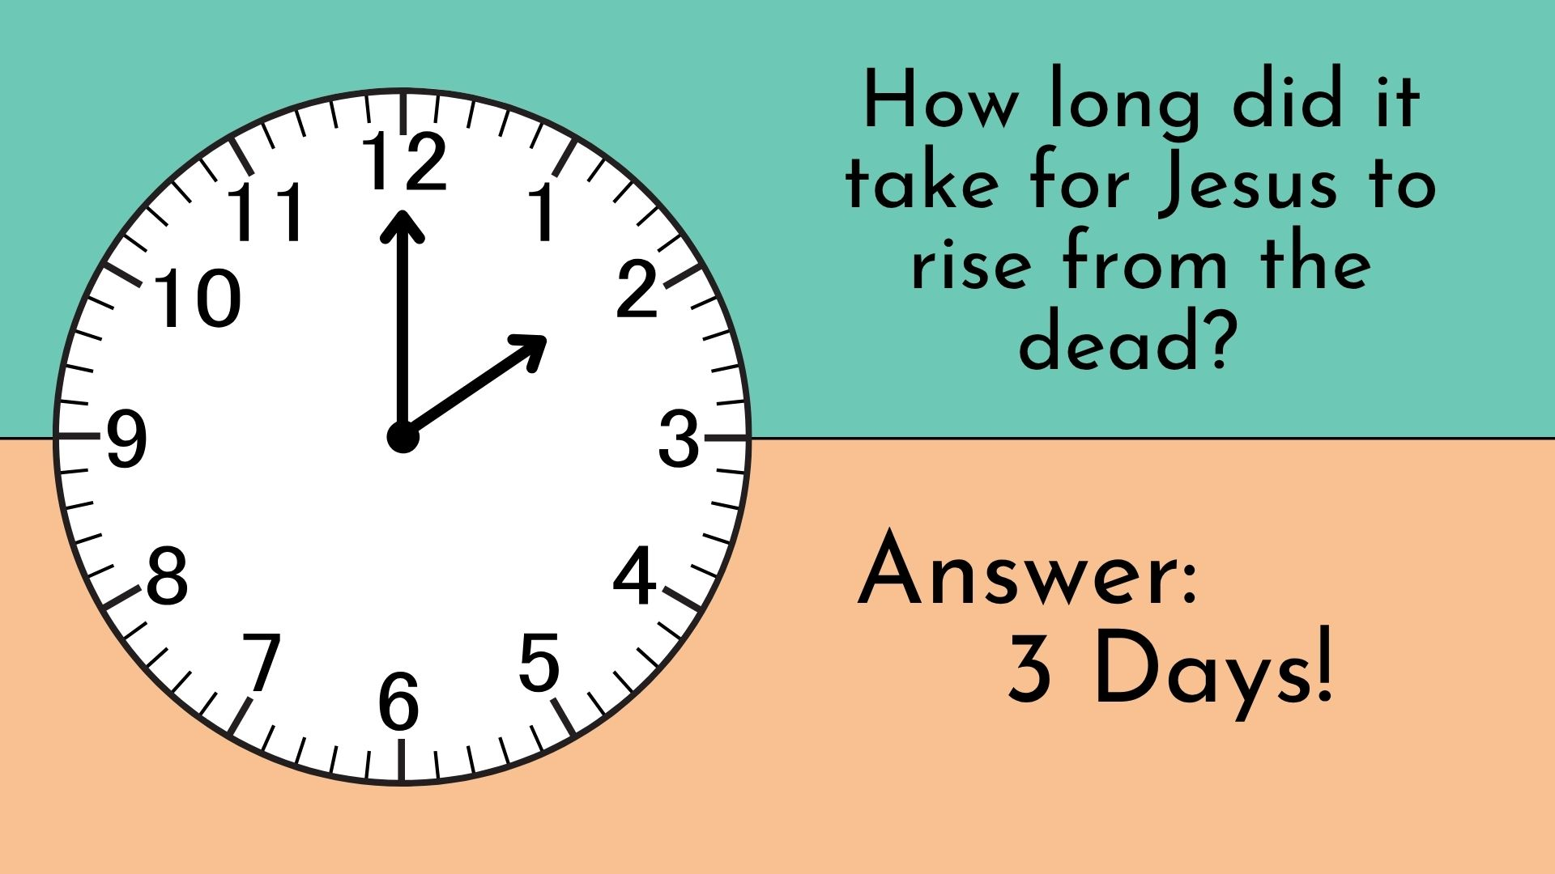

Slide 7
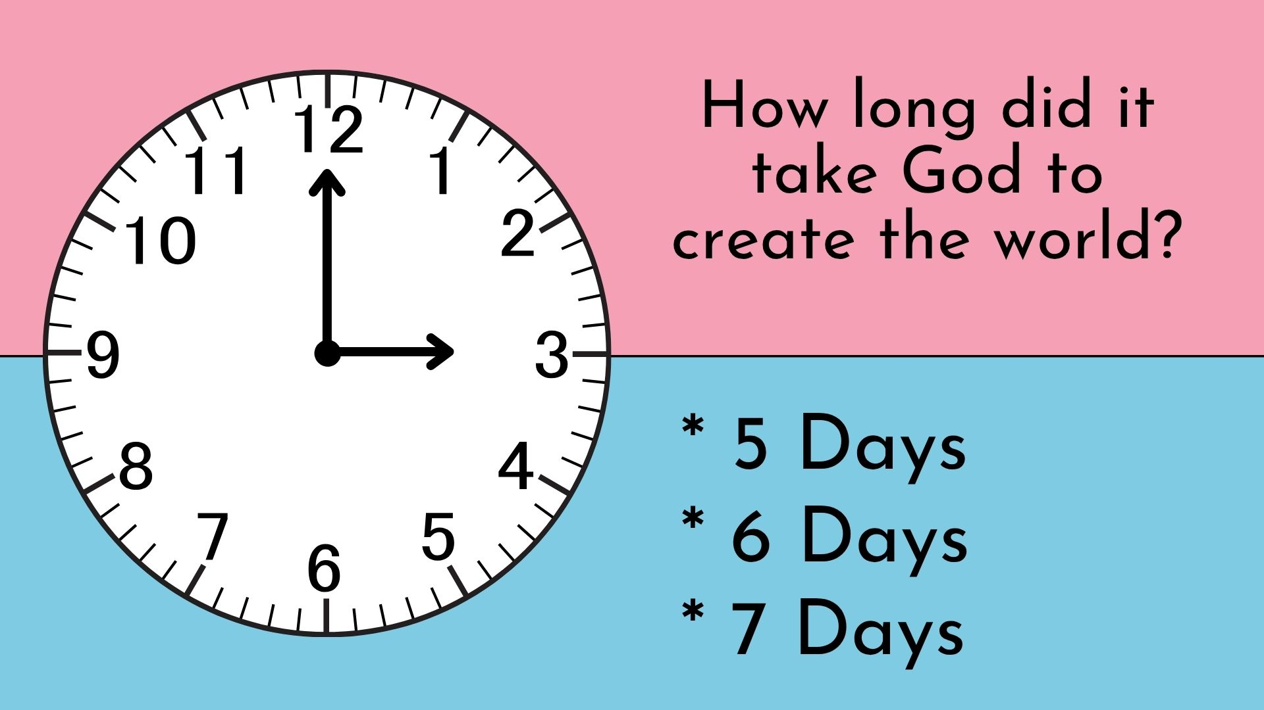

Slide 8
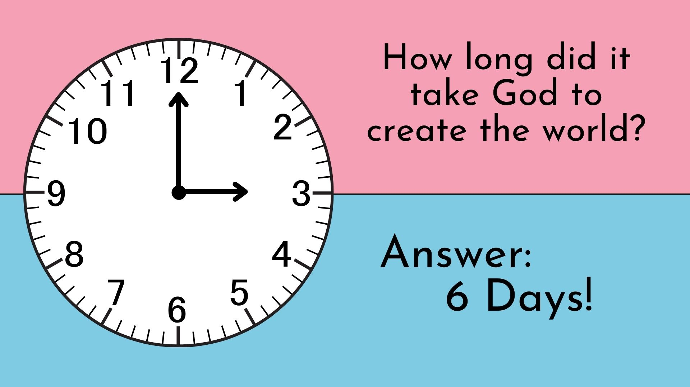

Slide 9
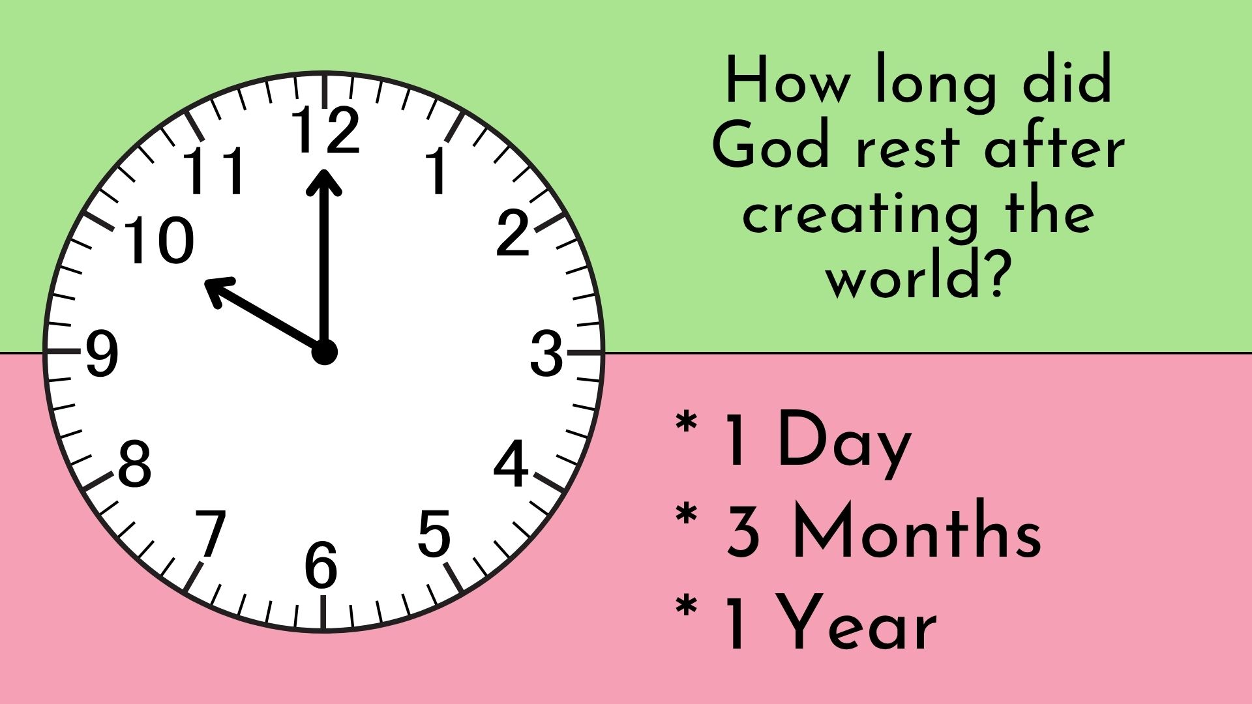

Slide 10
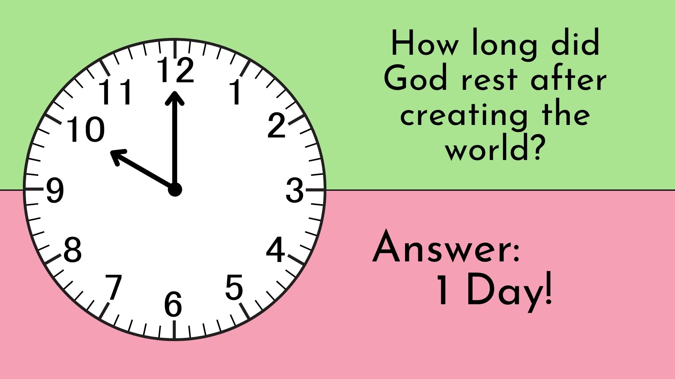

Slide 11
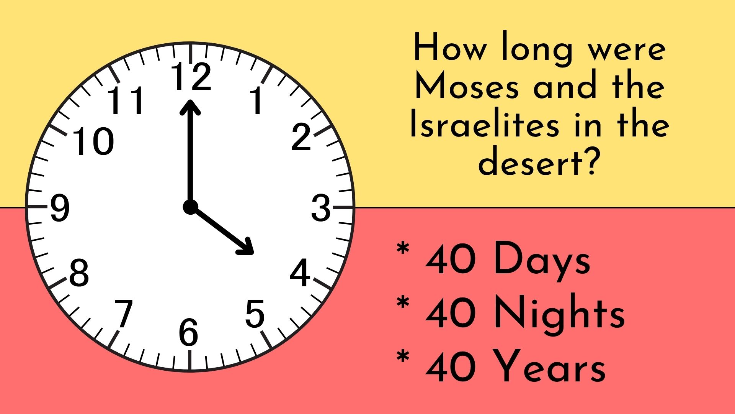

Slide 12
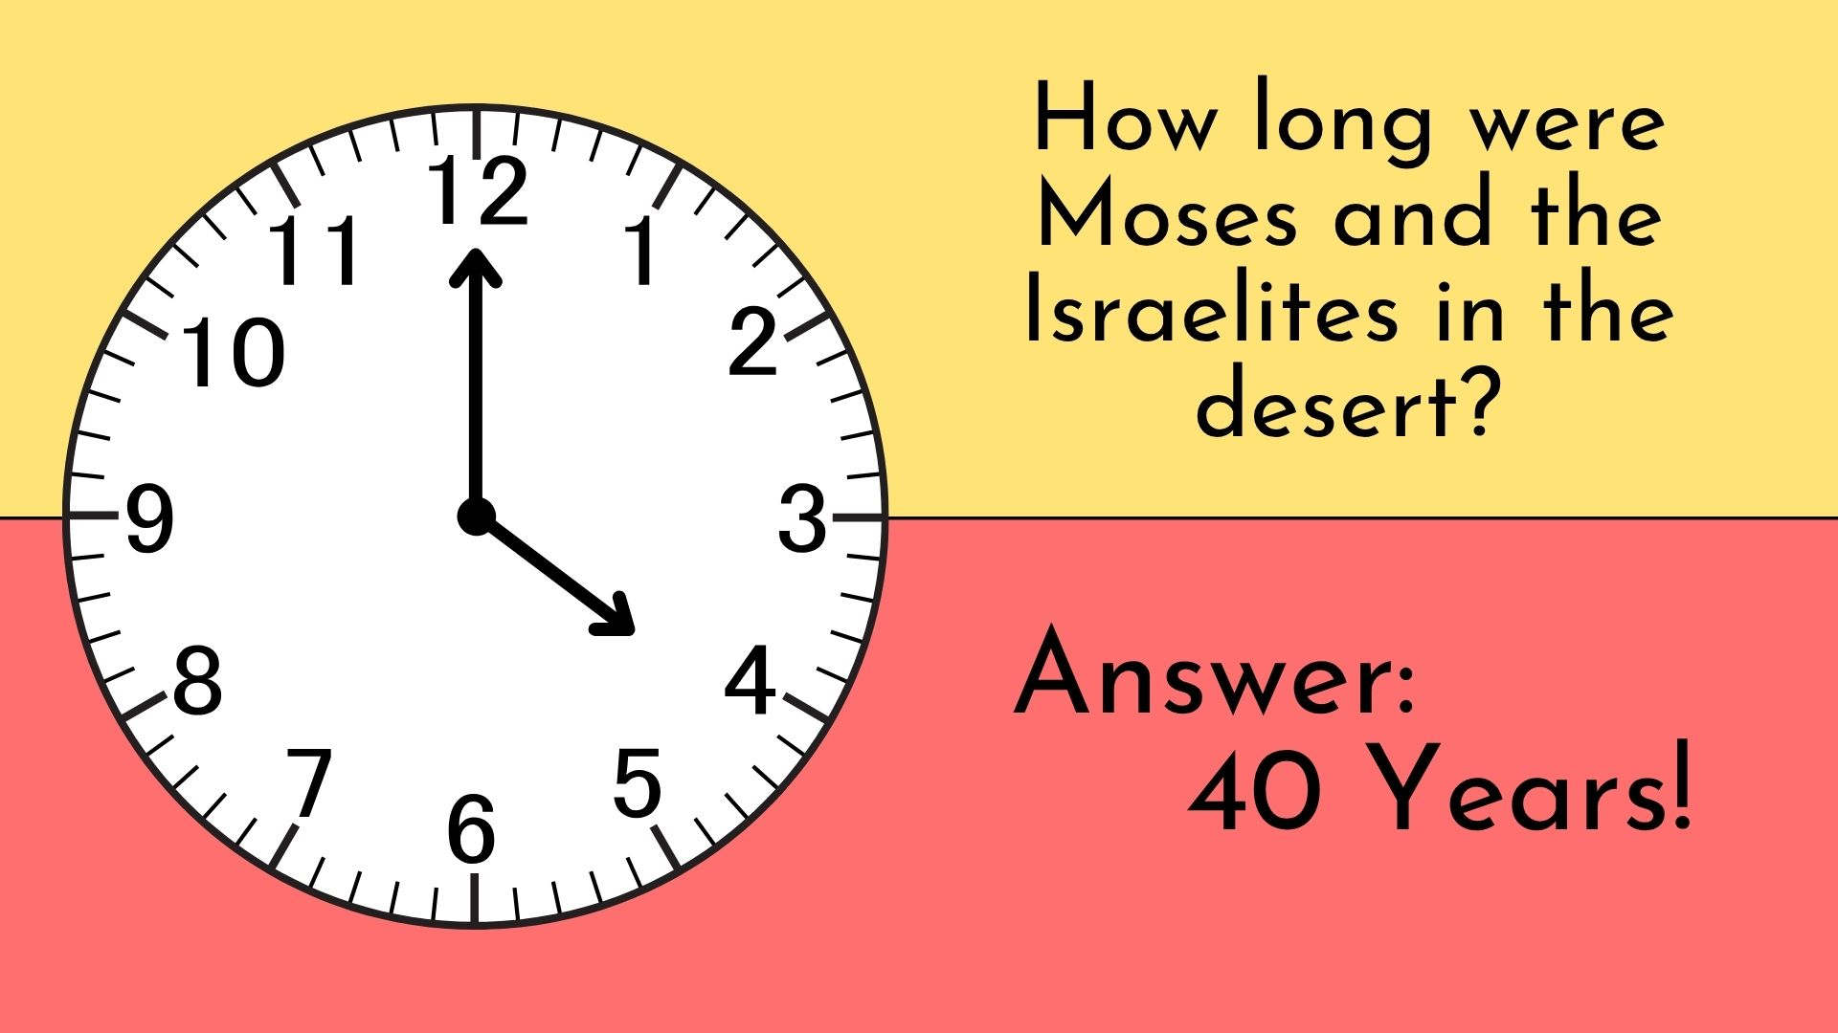

Slide 13
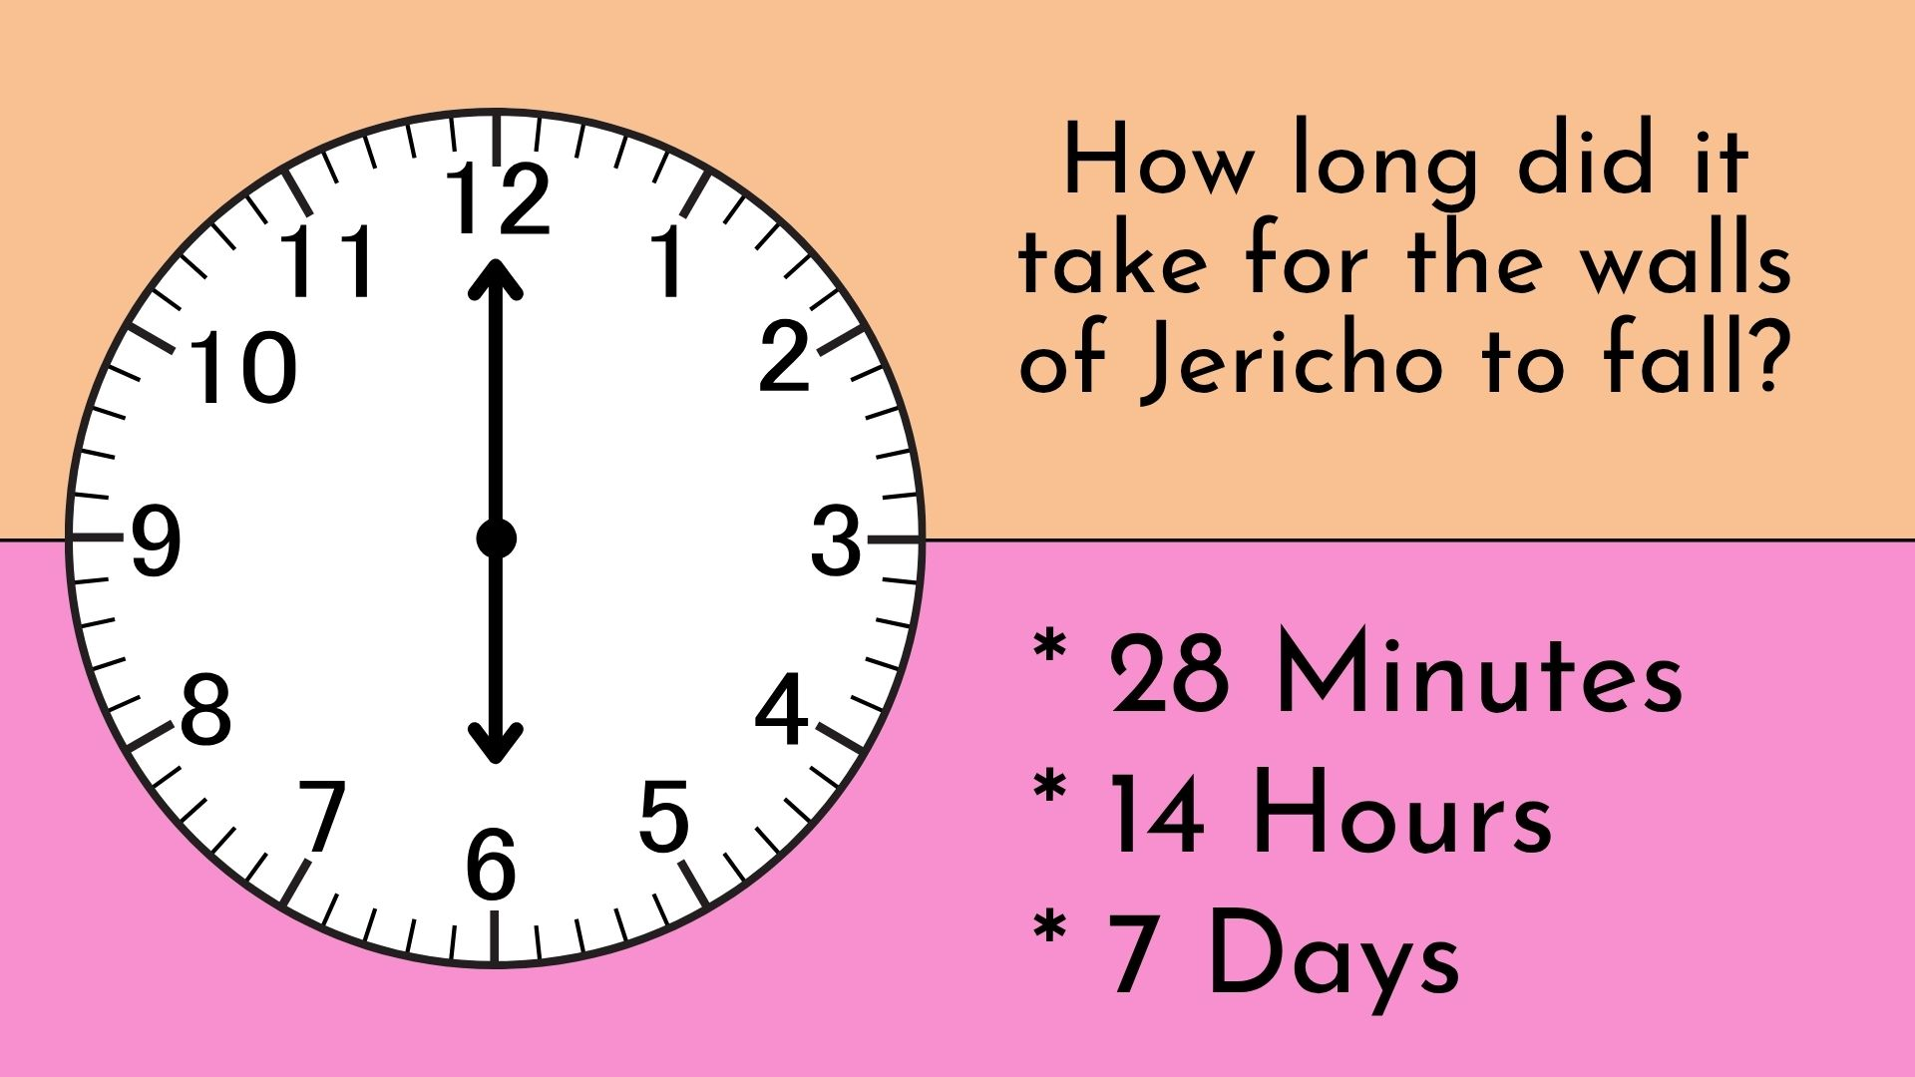

Slide 14
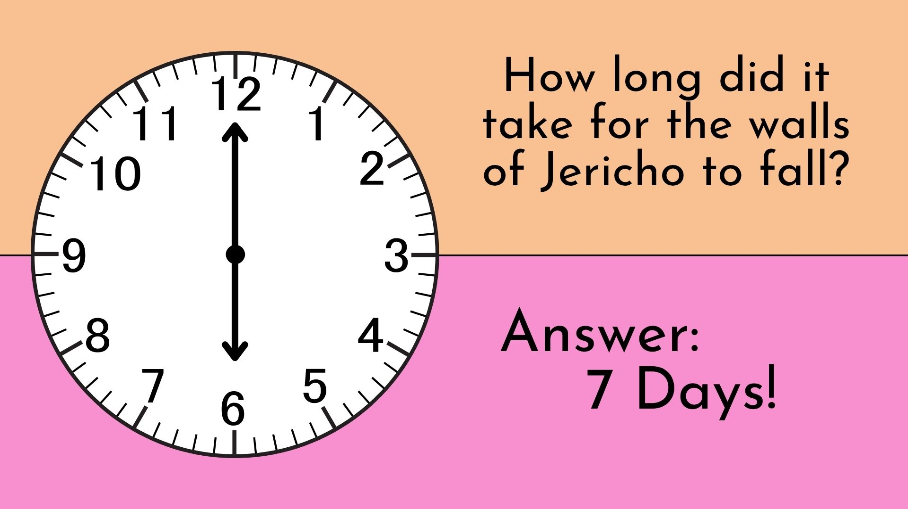

Slide 15
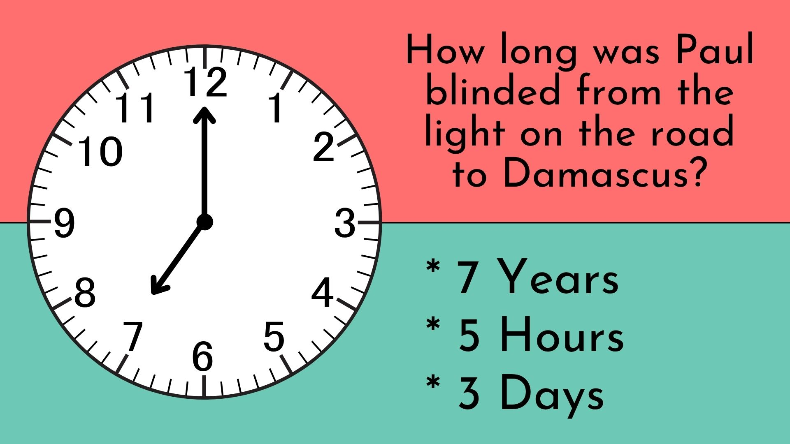

Slide 16
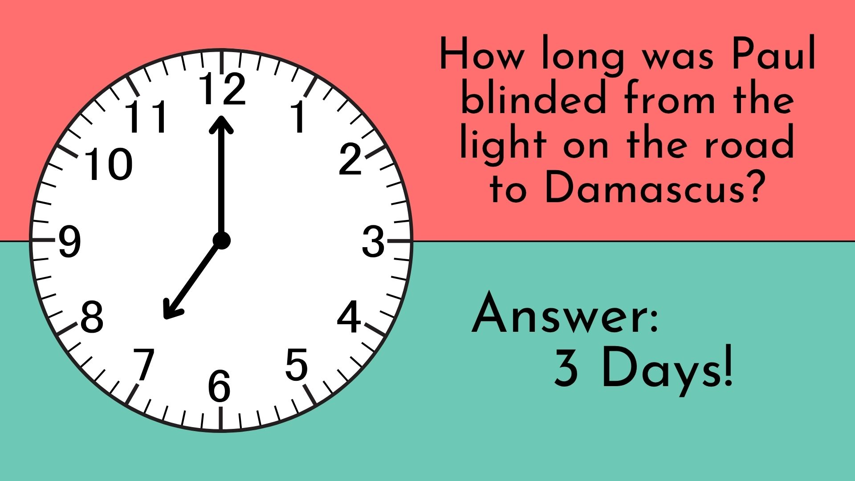

Slide 17
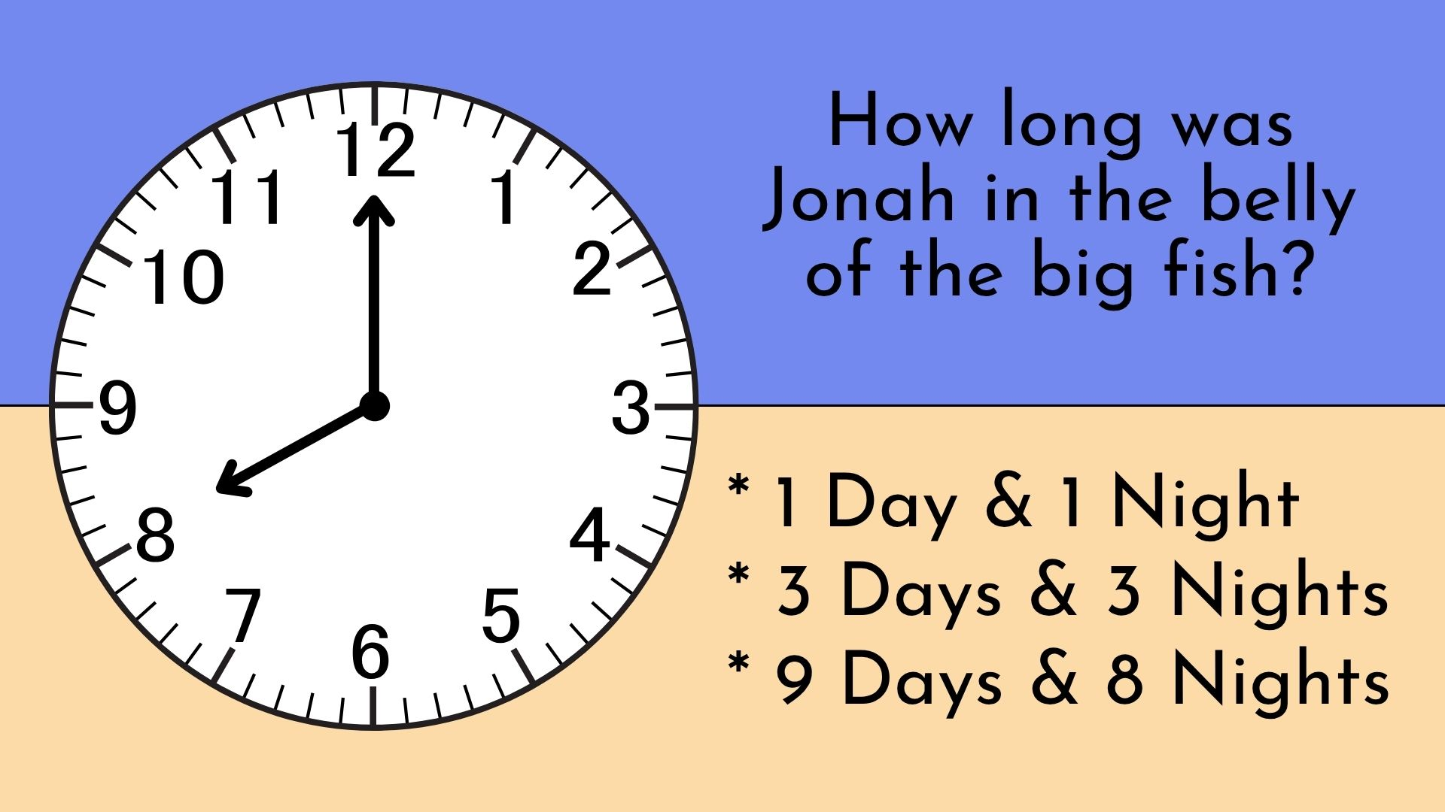

Slide 18
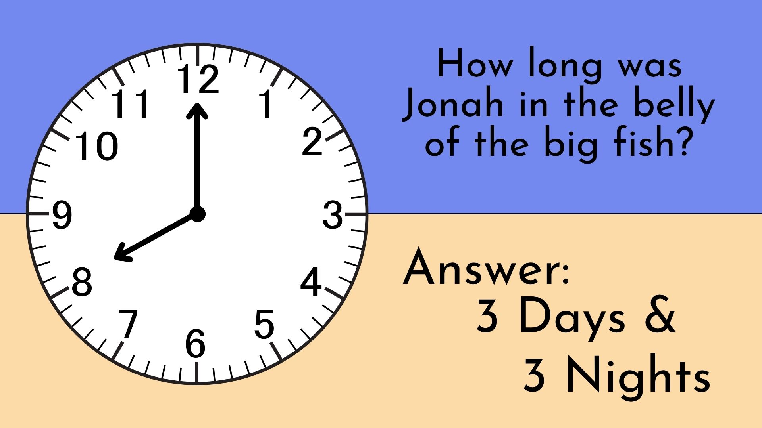

Slide 19
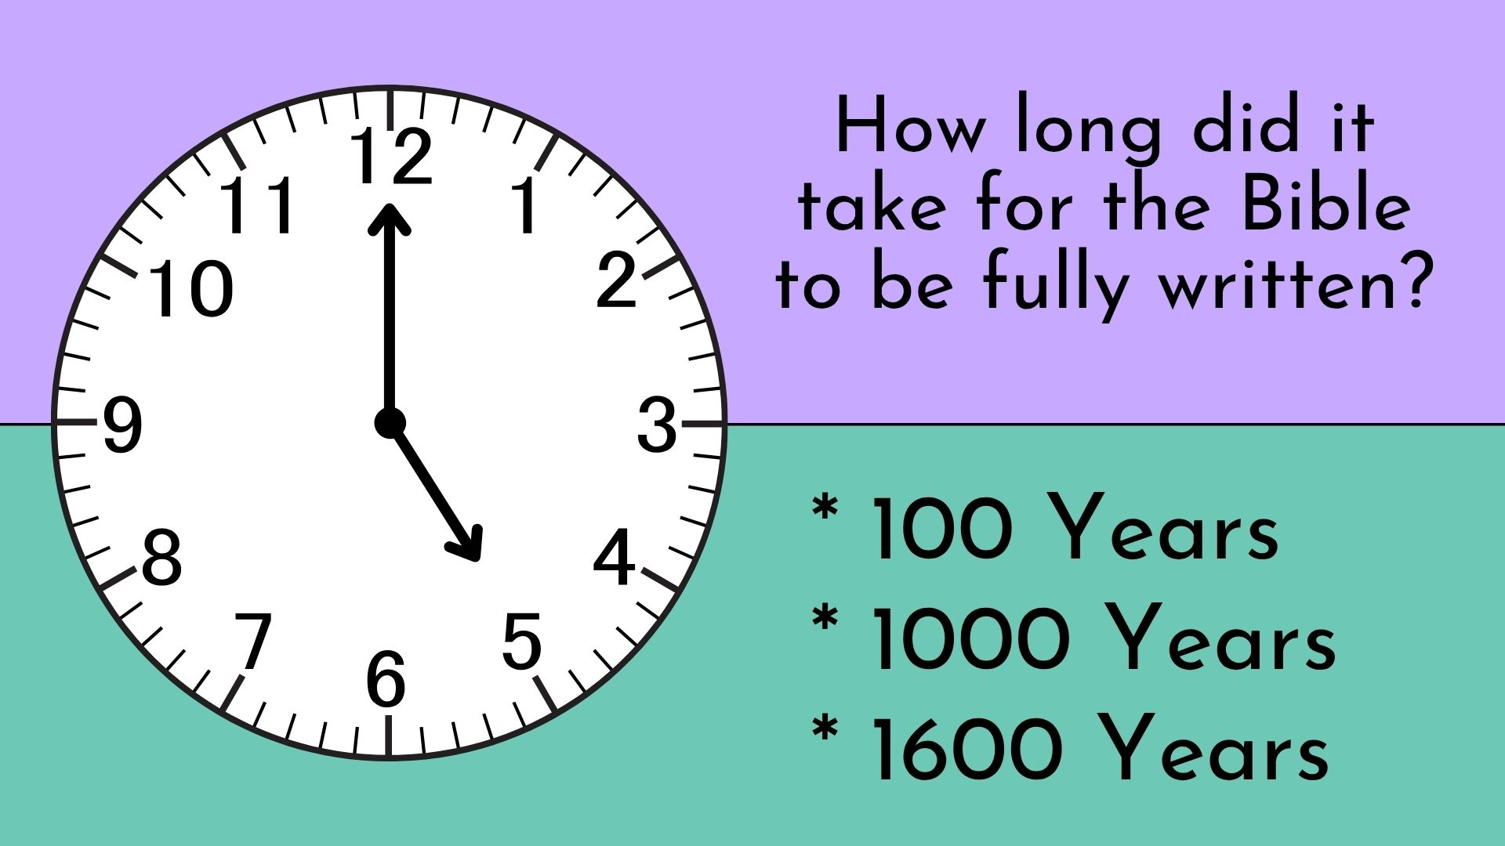

Slide 20
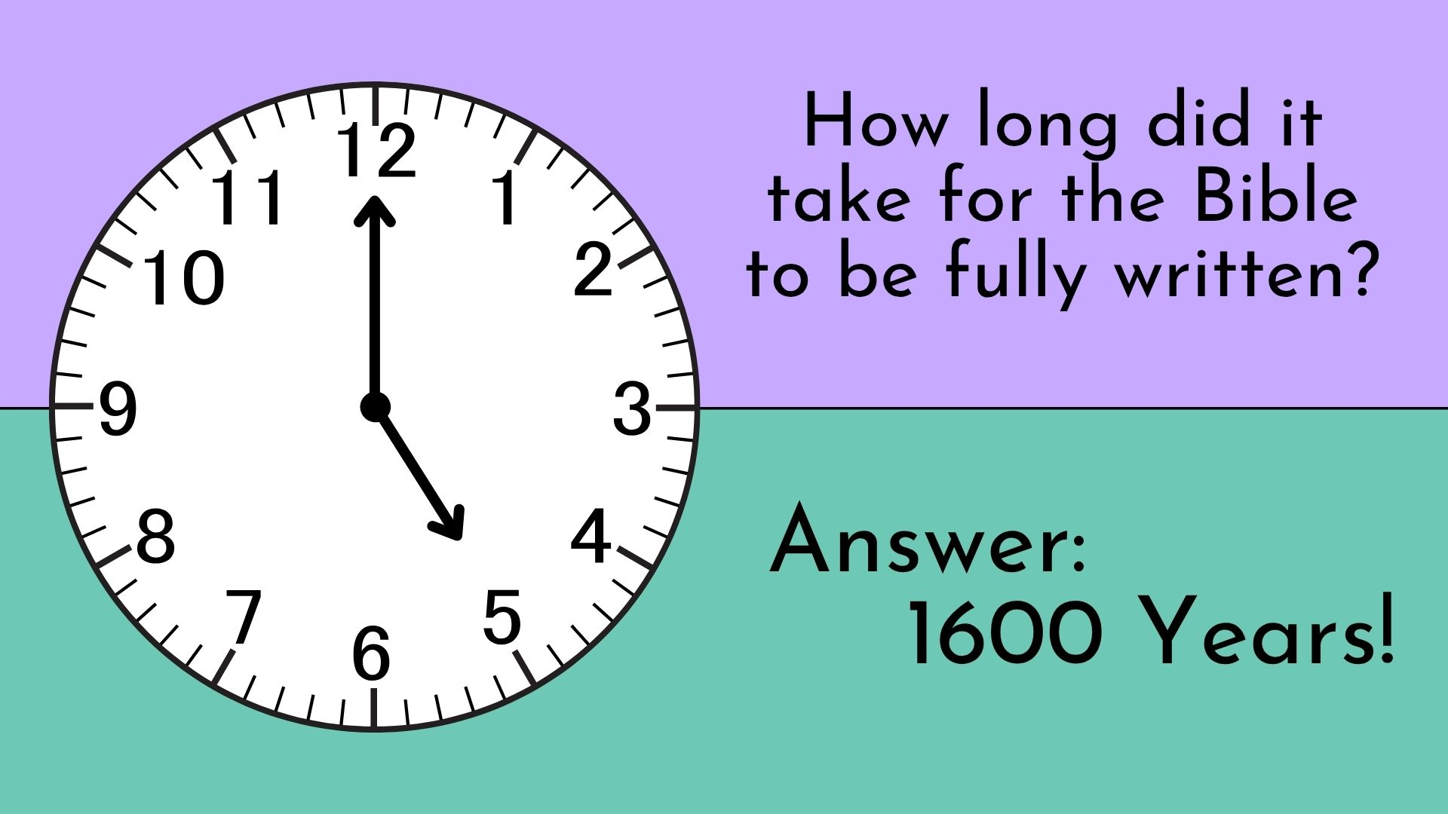

Slide 21
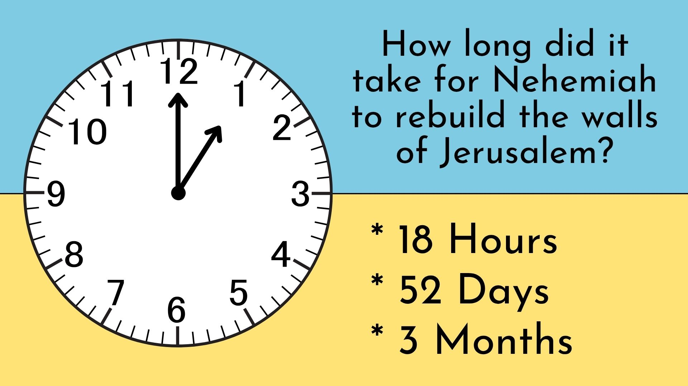

Slide 22
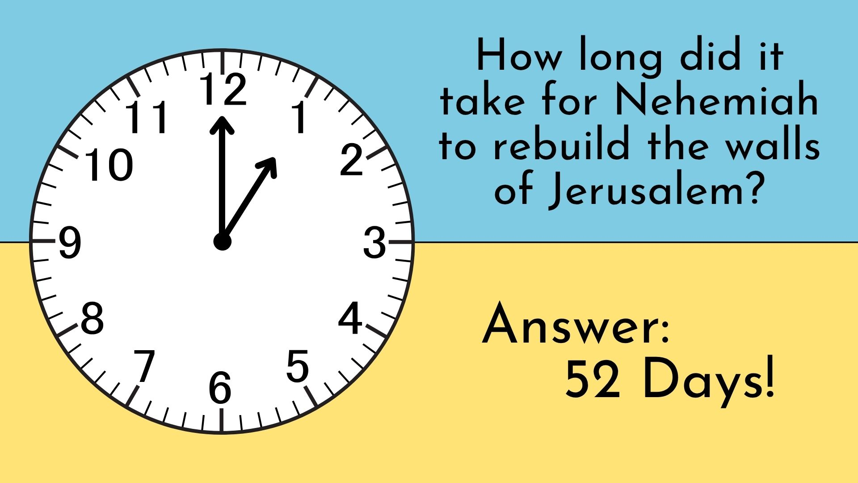

Slide 23
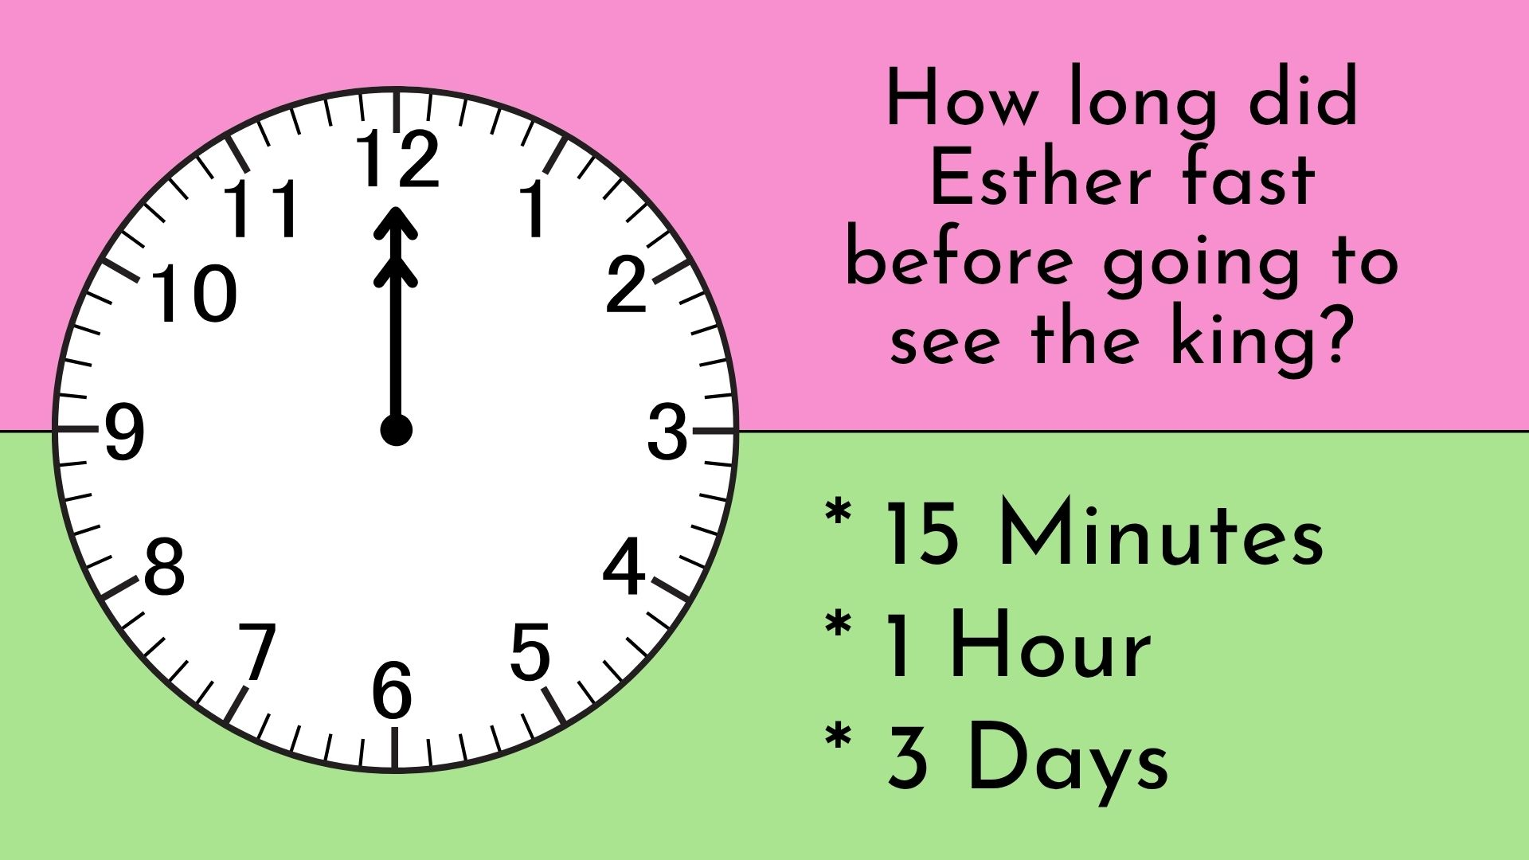

Slide 24
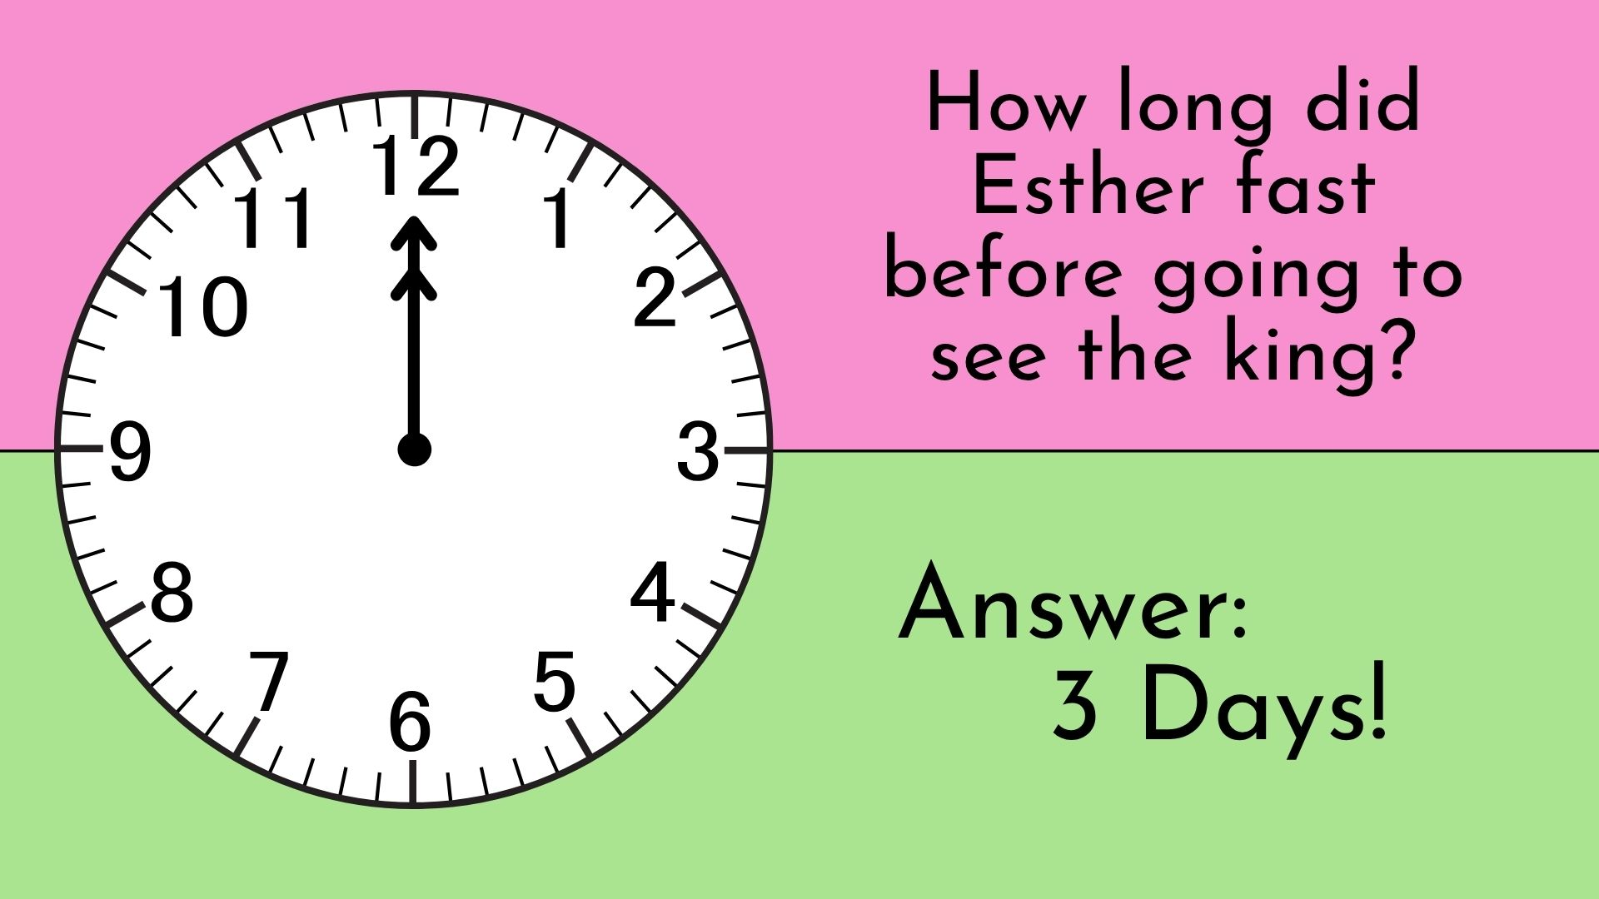

Slide 25


Slide 26
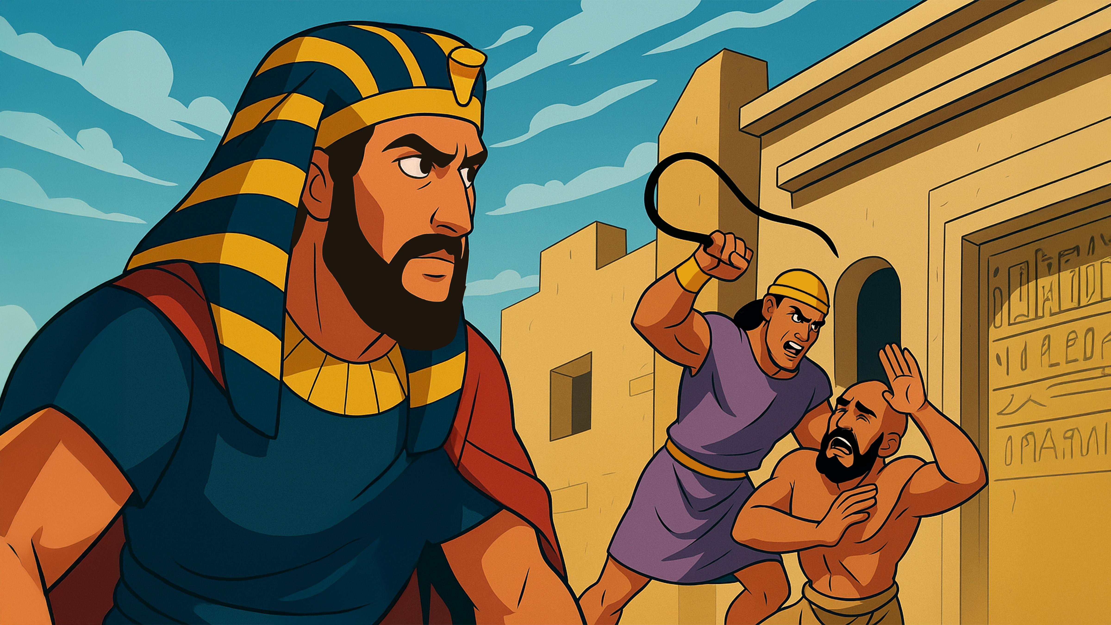

Slide 27
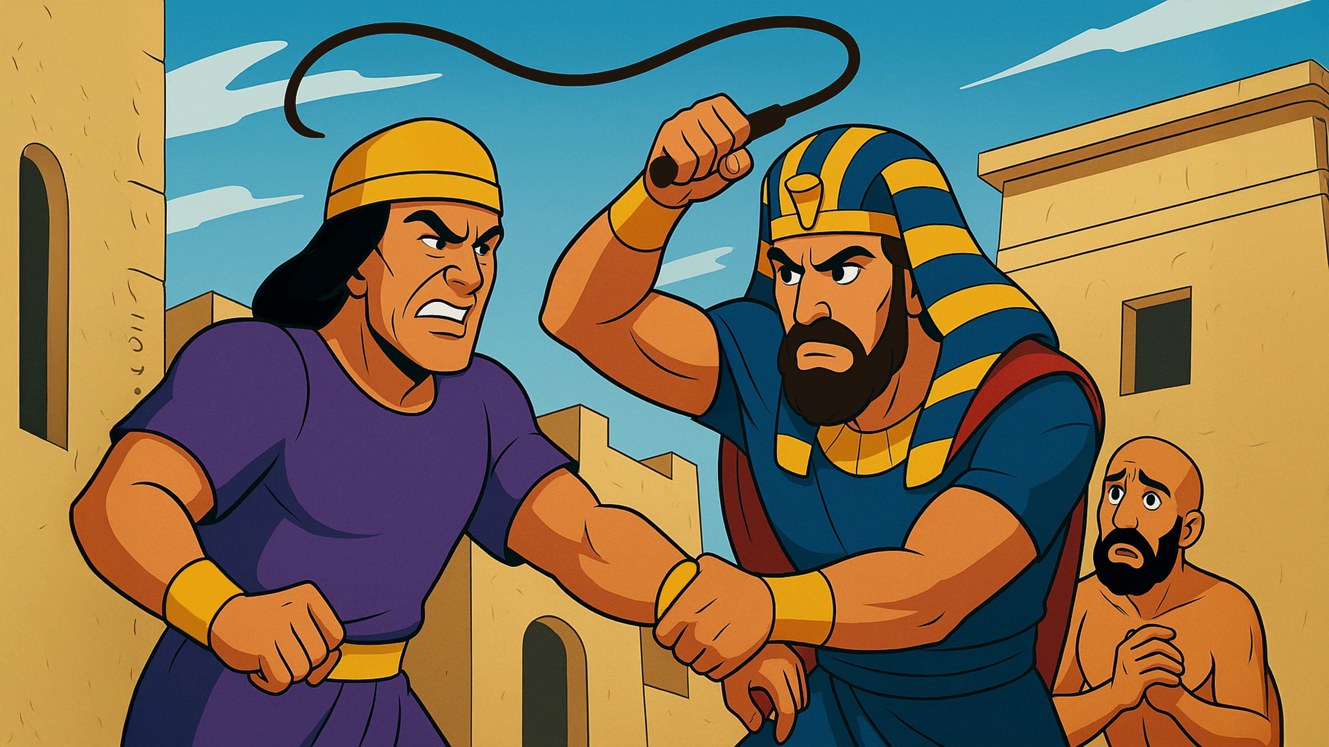

Slide 28
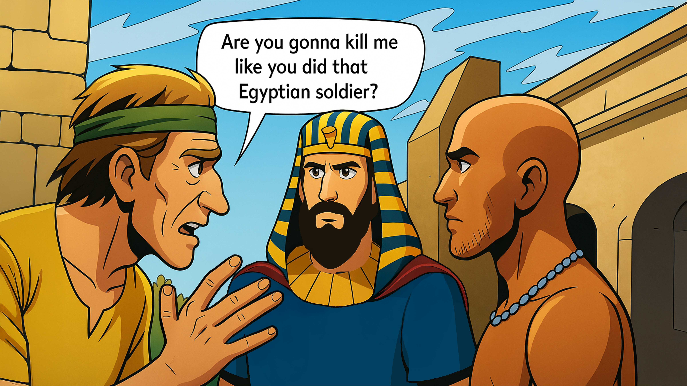

Slide 29
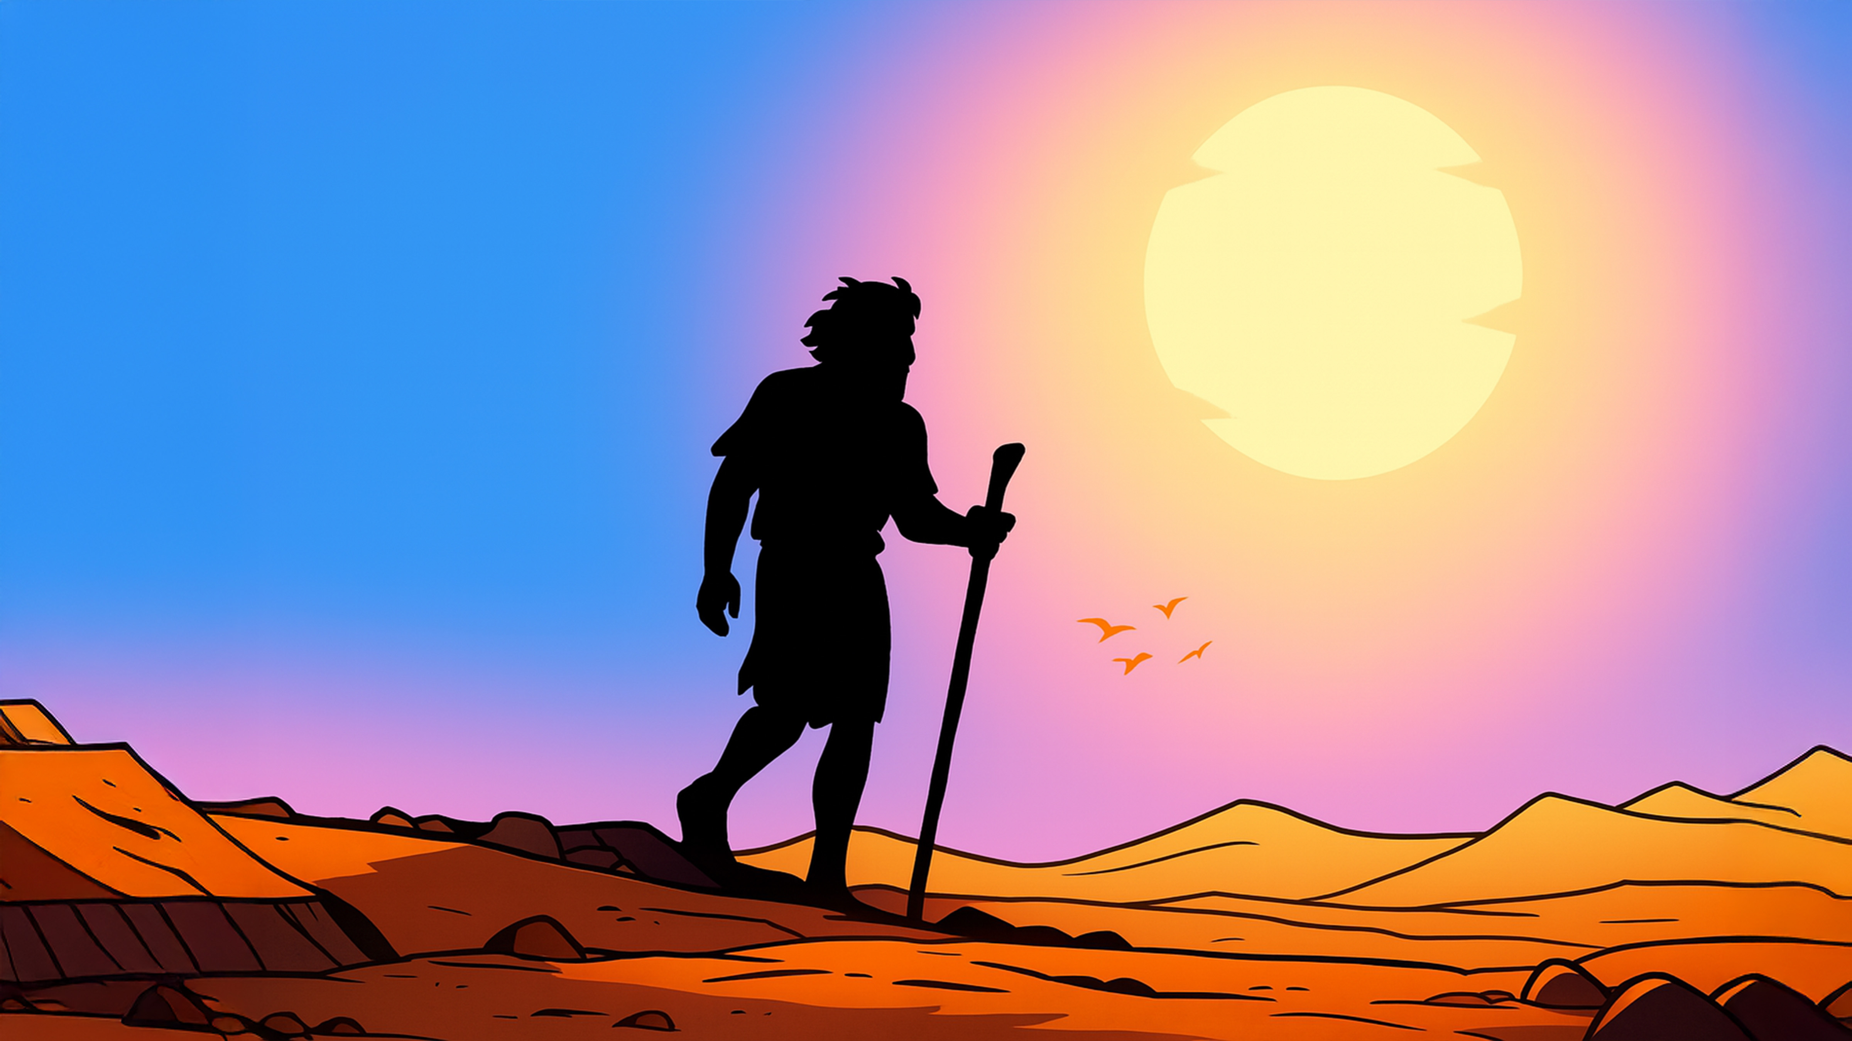

Slide 30
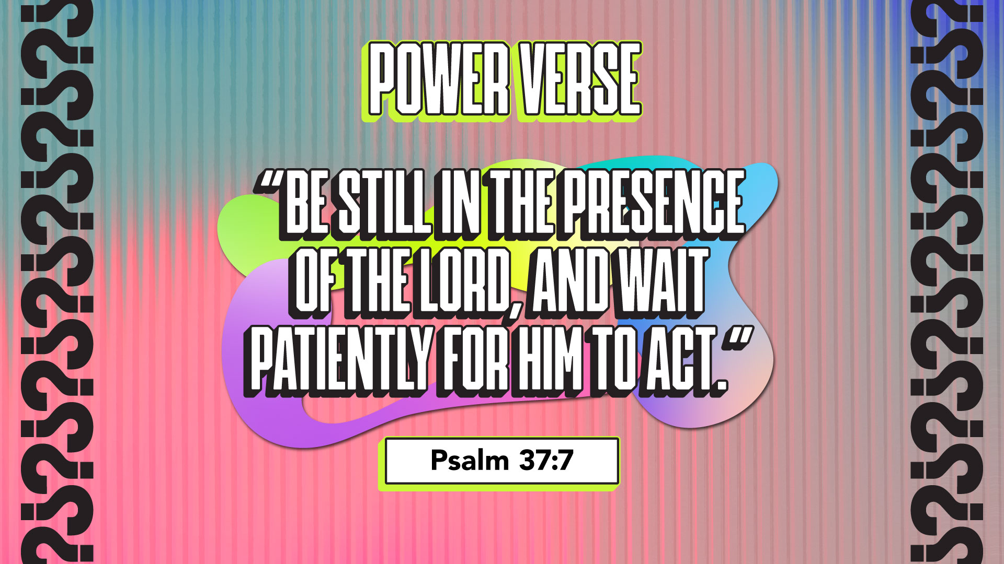

Slide 31


Slide 32


Slide 33


Slide 34


Slide 35


Slide 36


Slide 37

1. Whatchagaddaknow,
today?
* “God Will Trust Me!”
* “I Will Jump In Time!”
* “I Will Trust God’s
Timing And Not
Jump Ahead!”

Slide 38
1. Whatchagaddaknow,
today?
ANSWER:
“I Will Trust God’s
Timing And Not
Jump Ahead!”

Slide 39
2. What did Moses see that
made him angry?
* An Egyptian Soldier
Beating A Hebrew Slave
* A Man Running Barefoot
* Chickens Crossing The
Road

Slide 40
2. What did Moses see that
made him angry?
ANSWER:
An Egyptian Soldier
Beating A Hebrew
Slave

Slide 41
3. What did Moses do to the
soldier?
* Yelled At Him
* Killed Him
* Hugged Him

Slide 42
3. What did Moses do to the
soldier?
ANSWER:
Killed Him

Slide 43
4. Did Pharaoh find out what
Moses did?
* Yes
* No

Slide 44
4. Did Pharaoh find out what
Moses did?
ANSWER:
Yes

Slide 45
5. Where did Moses run?
* Into The Desert
* Into A Cave
* To His House

Slide 46
5. Where did Moses run?
ANSWER:
Into The Desert

Slide 47
6. According to our lesson
today, when I take things
into my own hands, “I Pay A
_______ ________.”
* Big Cost
* High Price
* Large Amount

Slide 48
6. According to our lesson
today, when I take things
into my own hands, “I Pay A
_______ ________.”
ANSWER:
High Price

Slide 49
7. According to our lesson
today, when I take things
into my own hands, “I _______
Others.”
* Help
* Honor
* Hurt

Slide 50
7. According to our lesson
today, when I take things
into my own hands, “I _______
Others.”
ANSWER:
Hurt

Slide 51
8. According to our lesson
today, when I take things
into my own hands, “I Make
God’s _______ Take Longer.”
* Plan
* Timing
* Ideas

Slide 52
8. According to our lesson
today, when I take things
into my own hands, “I Make
God’s _______ Take Longer.”
ANSWER:
Plan

Slide 53
9. If I make a mistake, is God’s
plan for my life over?
* Yes
* No

Slide 54
9. If I make a mistake, is God’s
plan for my life over?
ANSWER:
No

Slide 55
10. Where was our Power
Verse found?
* Pharaoh 7:3
* Moses 3:37
* Psalm 37:7

Slide 56
10. Where was our Power
Verse found?
ANSWER:
Psalm 37:7

