Slide 1


Slide 2


Slide 3


Slide 4
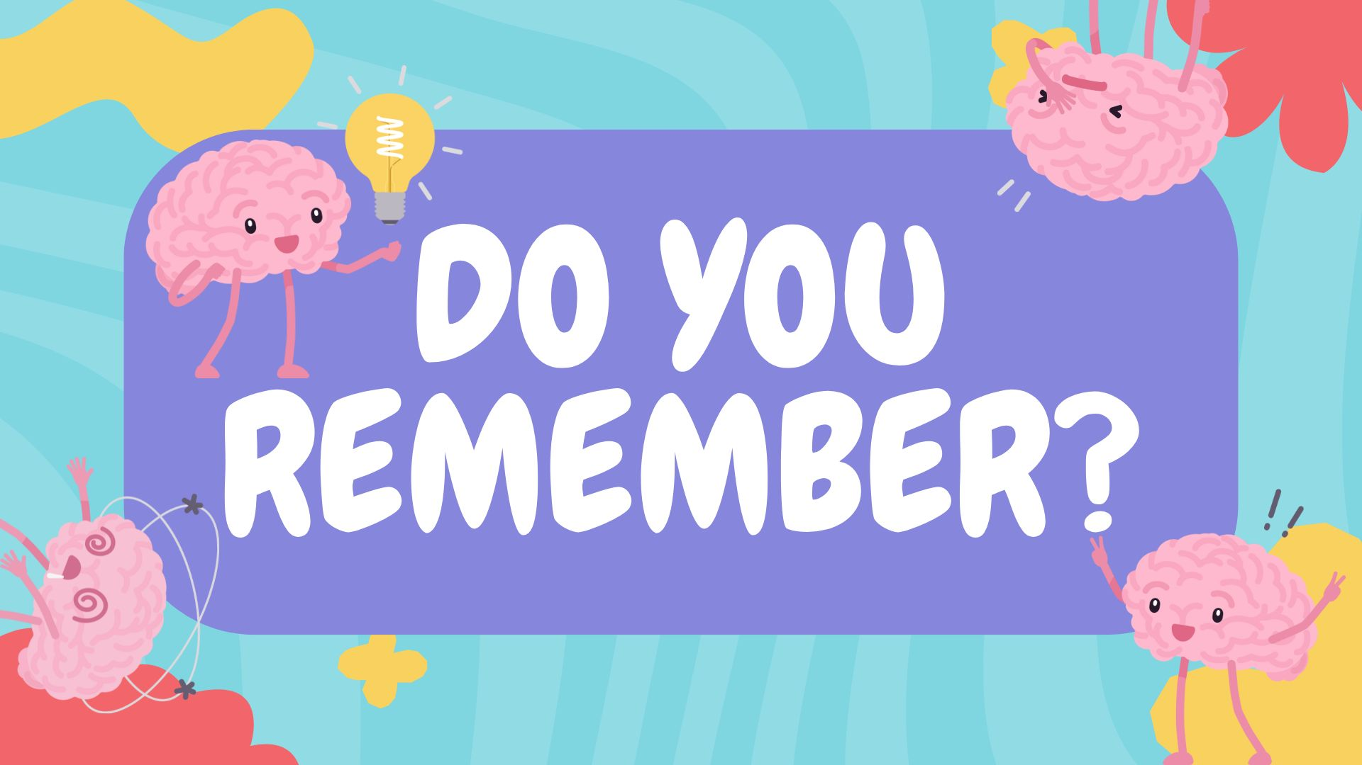

Slide 5


Slide 6
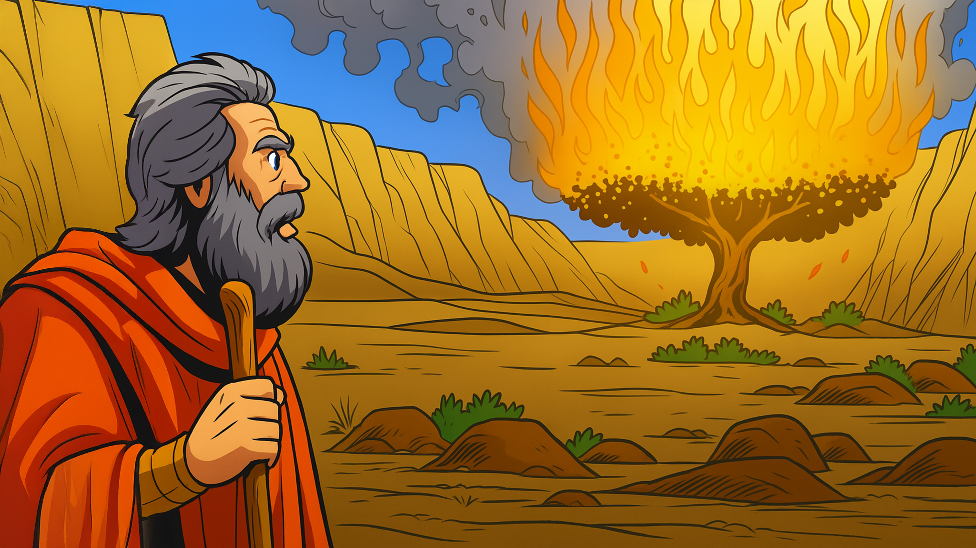

Slide 7
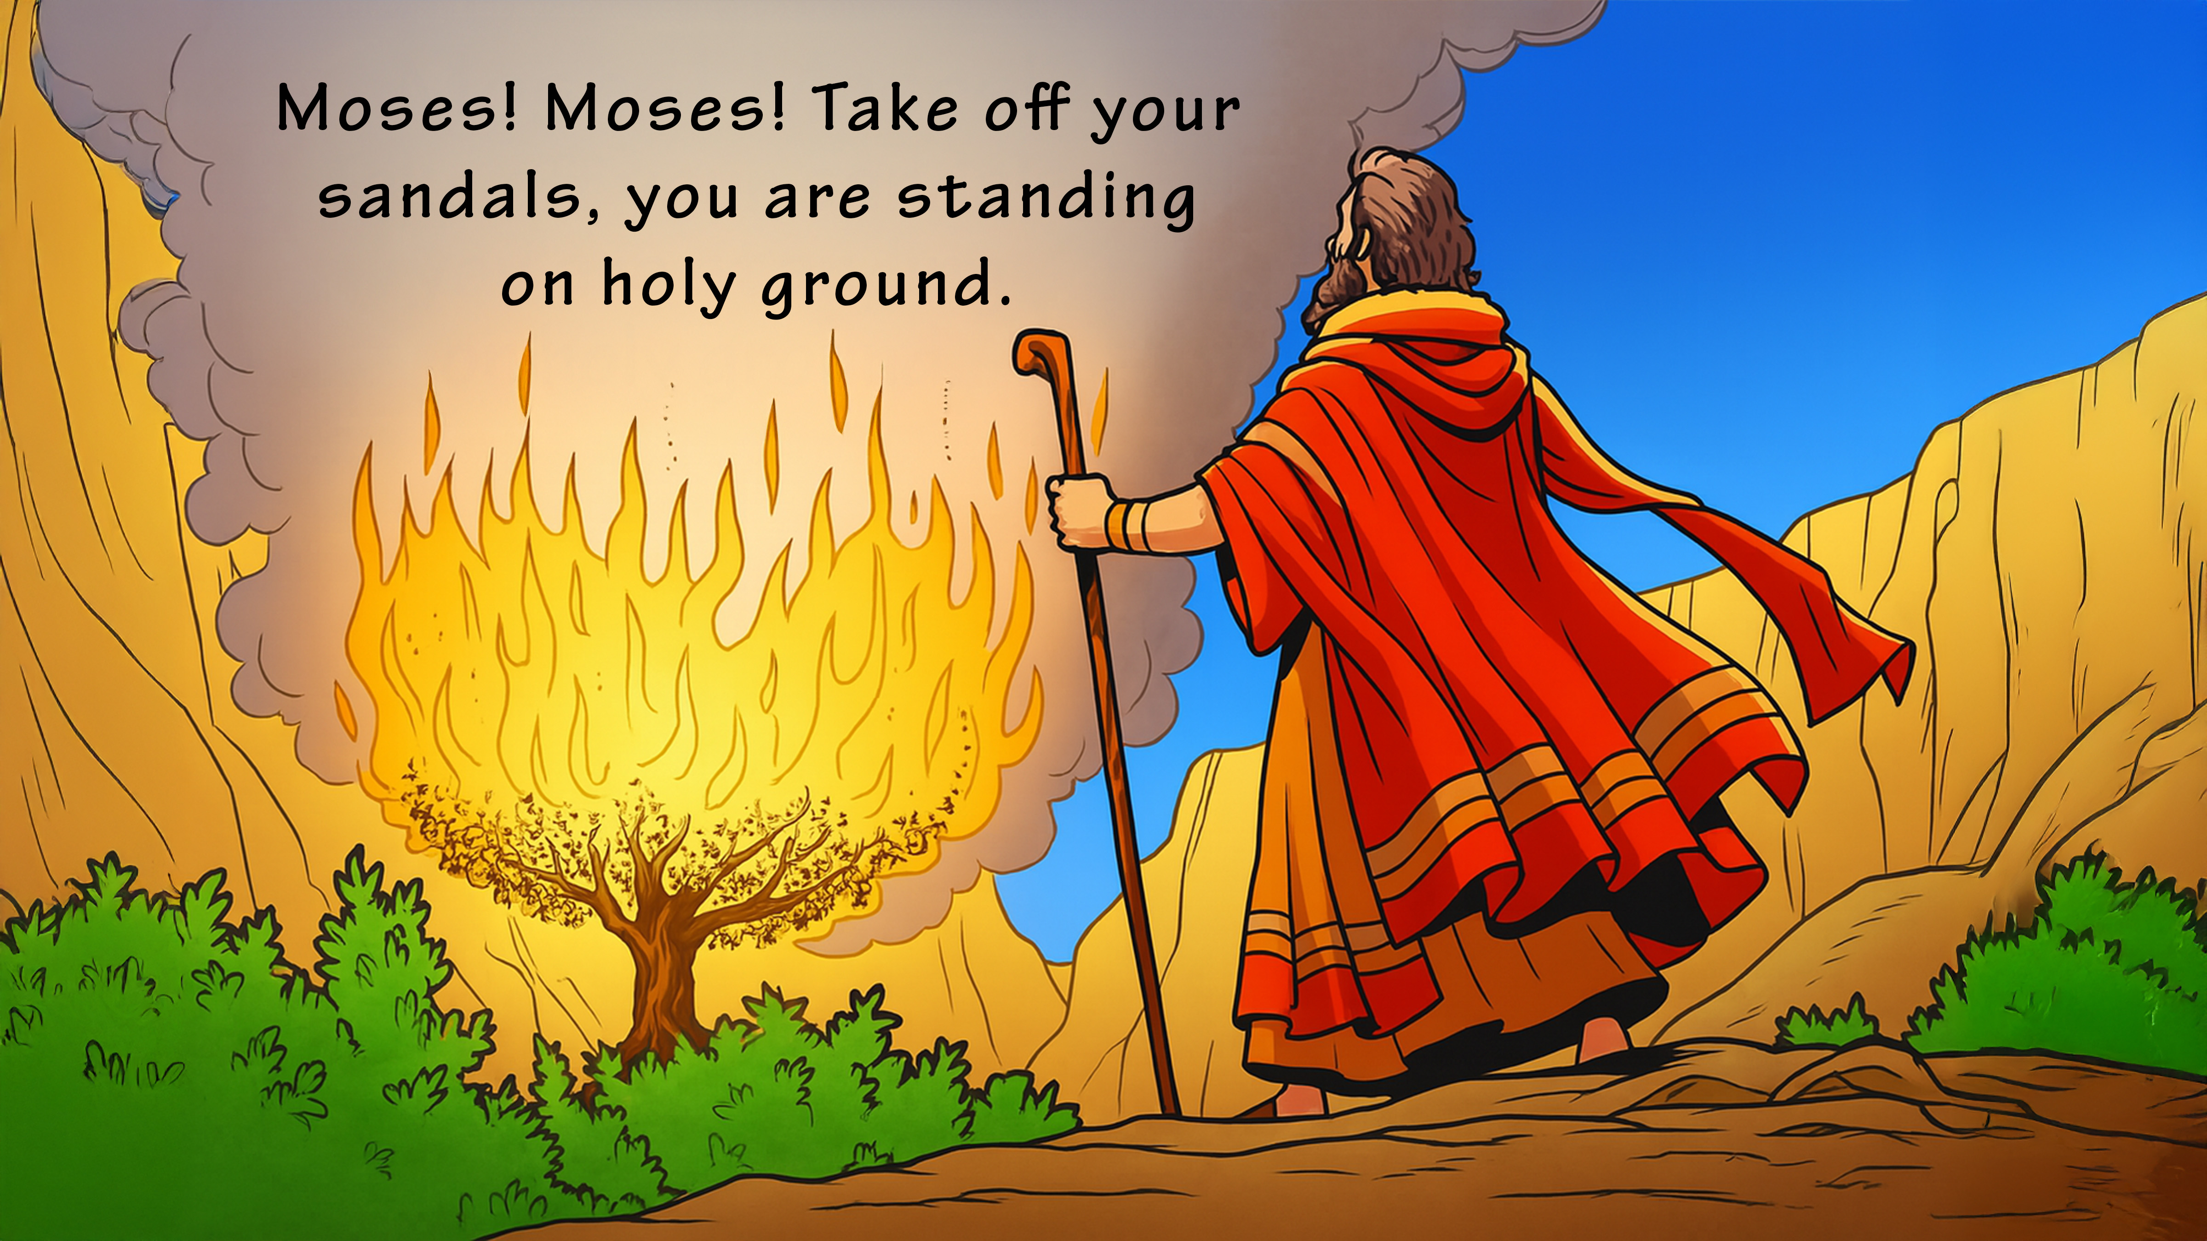

Slide 8
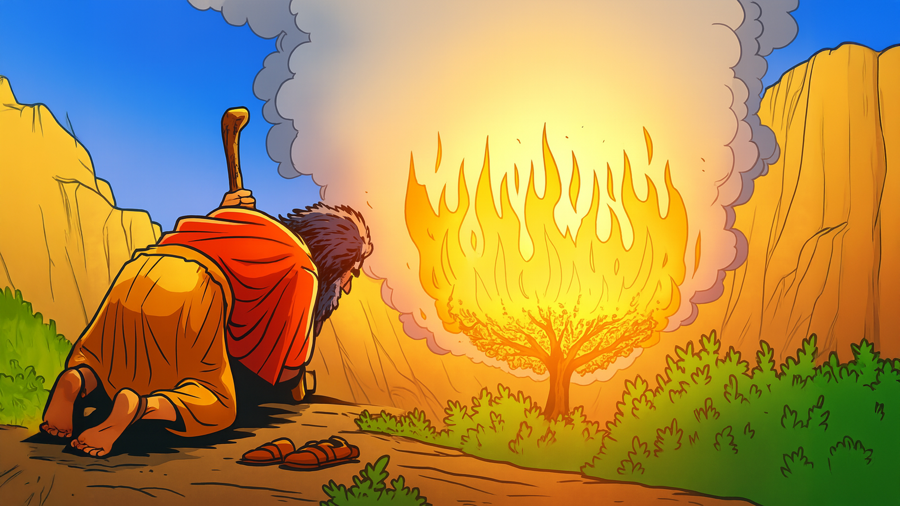

Slide 9
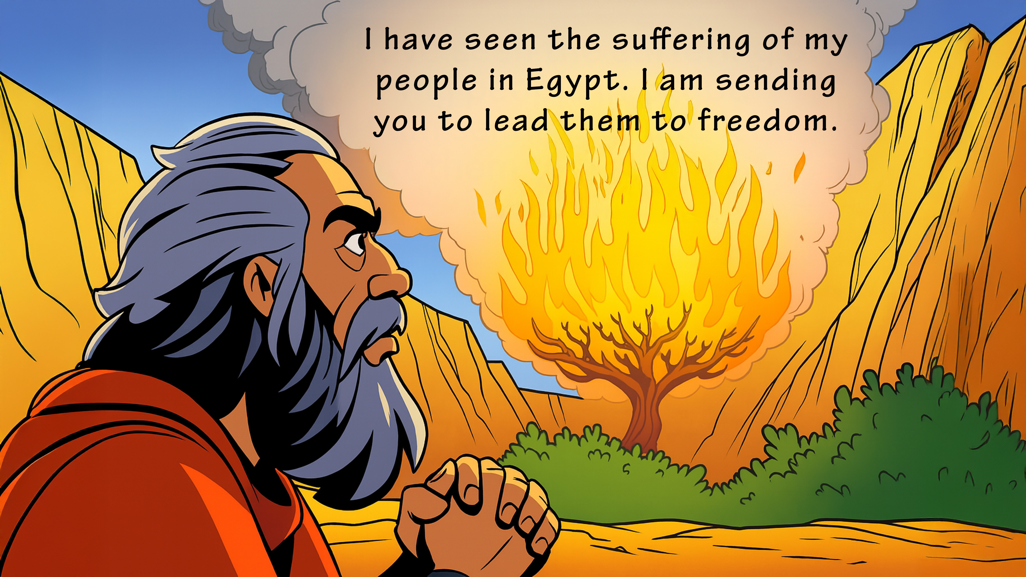

Slide 10
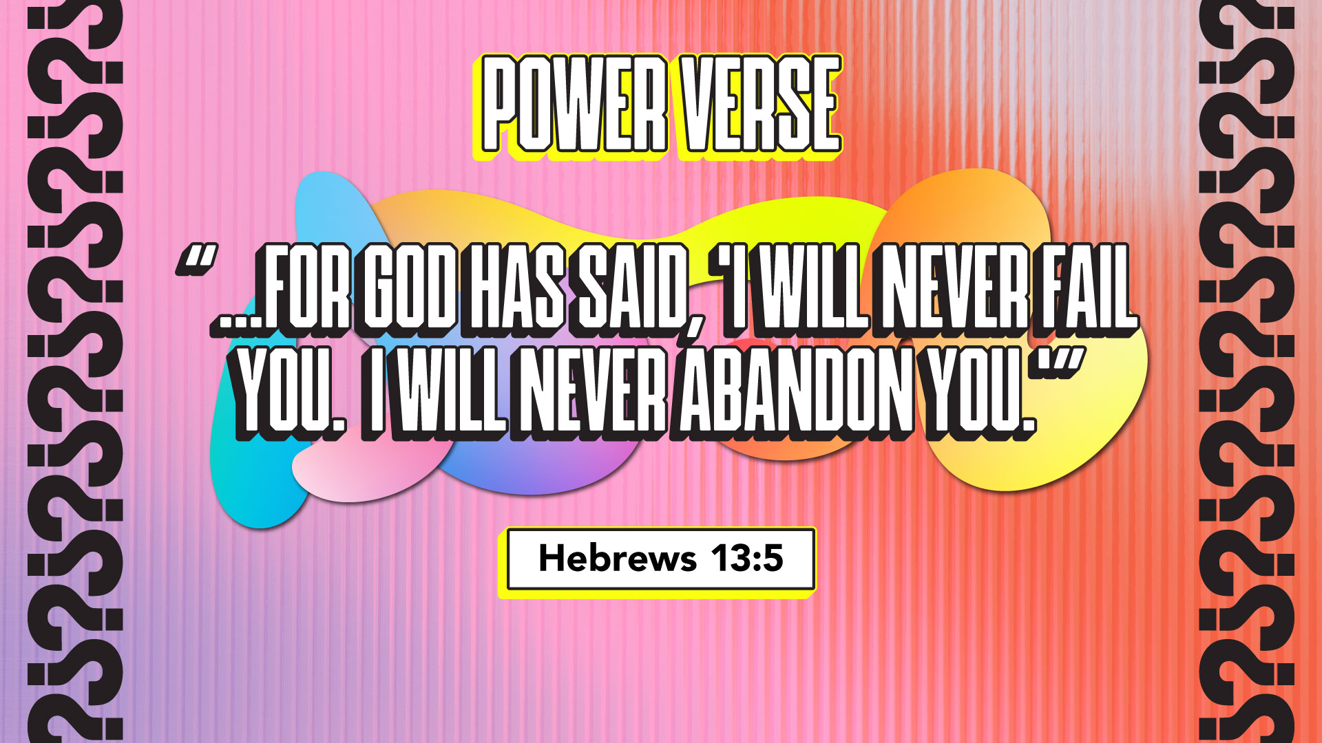

Slide 11


Slide 12


Slide 13


Slide 14


Slide 15


Slide 16


Slide 17

1. Whatchagaddaknow,
today?
* “God Will Never
Forget Me!”
* “I Forget Stuff!”
* “God Never Forgets!”

Slide 18
1. Whatchagaddaknow,
today?
ANSWER:
“God Will Never
Forget Me!”

Slide 19
2. What did Moses see while he
was watching his flocks?
* A Giant Bear
* A Burning Bush
* A Fiery Furnace

Slide 20
2. What did Moses see while he
was watching his flocks?
ANSWER:
A Burning Bush

Slide 21
3. Who spoke out of the bush?
* Moses
* God
* Pharaoh

Slide 22
3. Who spoke out of the bush?
ANSWER:
God

Slide 23
4. Why did God tell Moses to
take off his shoes?
* His Shoes Were Dirty
* He Was Sinking In Sand
* He Was On Holy Ground

Slide 24
4. Why did God tell Moses to
take off his shoes?
ANSWER:
He Was On Holy Ground

Slide 25
5. Did the bush burn up
completely?
* Yes
* No

Slide 26
5. Did the bush burn up
completely?
ANSWER:
No

Slide 27
6. According to our lesson
today, “God Knows Right
_________ I Am.”
* Where
* Who
* What

Slide 28
6. According to our lesson
today, “God Knows Right
_________ I Am.”
ANSWER:
Where

Slide 29
7. According to our lesson
today, “God Can _________ Me
Anywhere.”
* Find
* Help
* Meet

Slide 30
7. According to our lesson
today, “God Can _________ Me
Anywhere.”
ANSWER:
Meet

Slide 31
8. According to our lesson
today, “God STILL Has A
________ For Me.”
* Way
* Plan
* Job

Slide 32
8. According to our lesson
today, “God STILL Has A
________ For Me.”
ANSWER:
Plan

Slide 33
9. Did God forget about His
suffering people in Egypt?
* Yes
* No

Slide 34
9. Did God forget about His
suffering people in Egypt?
ANSWER:
No

Slide 35
10. Where was our Power
Verse found?
* Hebrews 13:5
* Habakkuk 5:3
* Harmony 3:1

Slide 36
10. Where was our Power
Verse found?
ANSWER:
Hebrews 13:5

