Slide 1


Slide 2


Slide 3


Slide 4


Slide 5


Slide 6
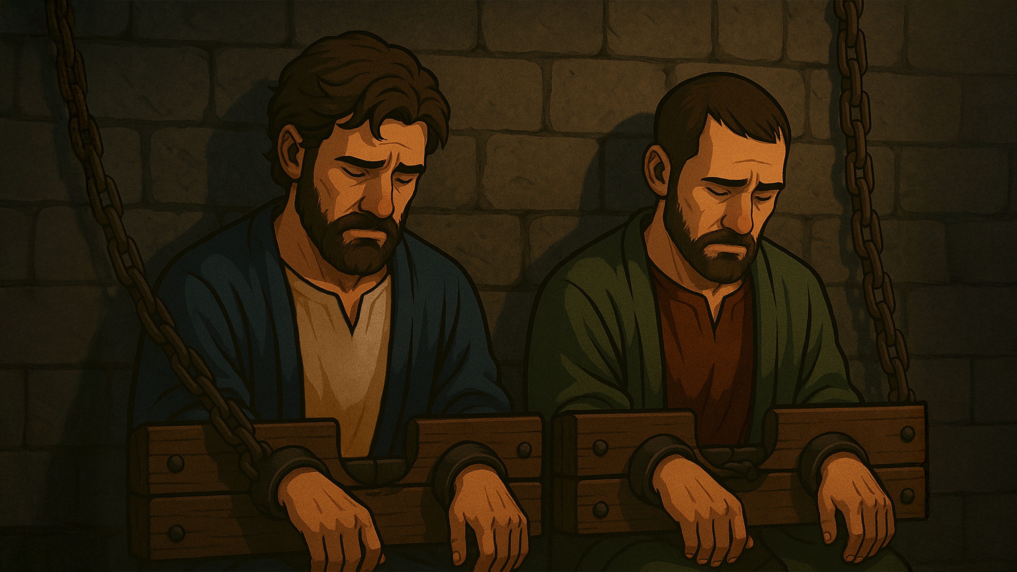

Slide 7
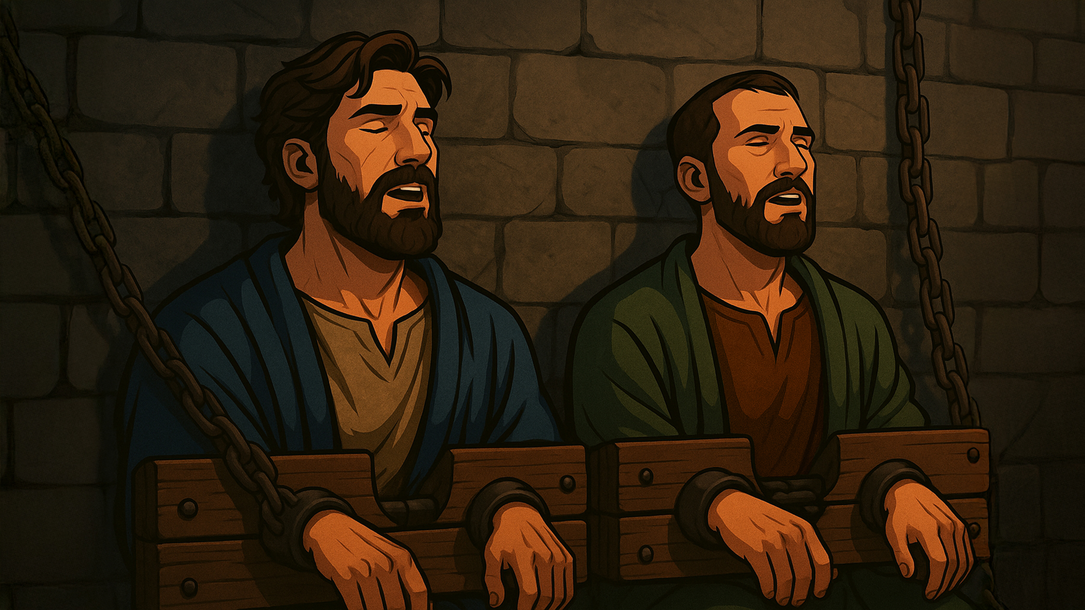

Slide 8
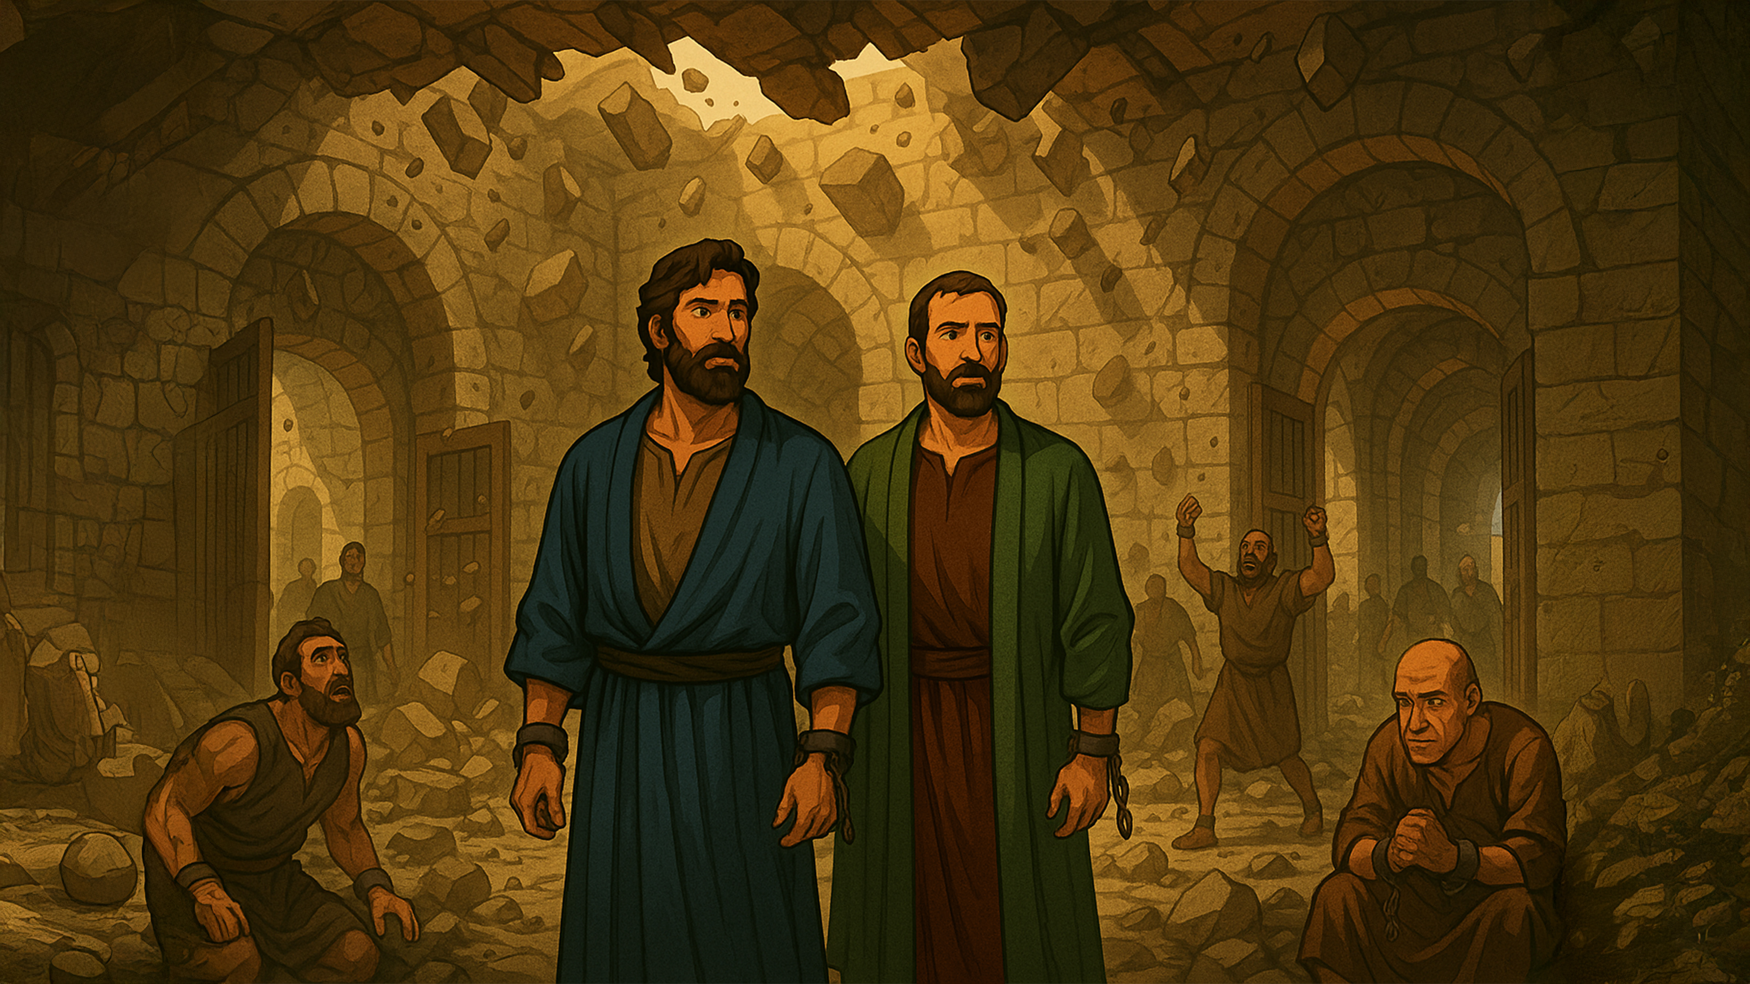

Slide 9
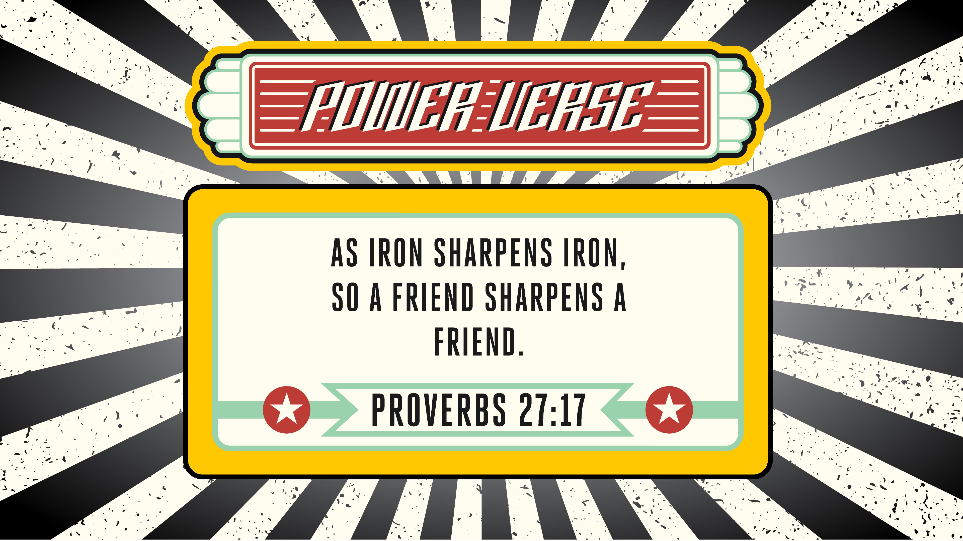

Slide 10


Slide 11


Slide 12


Slide 13


Slide 14


Slide 15


Slide 16

1. Whatchagaddaknow,
today?
* “I Want To Be Friends!”
* “Let’s Lift Each Other!”
* “I Will Choose Friends
Who Lift Me Up!”

Slide 17
1. Whatchagaddaknow,
today?
ANSWER:
“I Will Choose Friends
Who Lift Me Up!”

Slide 18
2. What happened while Paul
and Silas were in jail?
* An Earthquake
* A Tornado
* A Flood

Slide 19
2. What happened while Paul
and Silas were in jail?
ANSWER:
An Earthquake

Slide 20
3. True or False: Everyone in
the jail slept through the
earthquake.
* True
* False

Slide 21
3. True or False: Everyone in
the jail slept through the
earthquake.
ANSWER:
False

Slide 22
4. What did the earthquake
cause to happen?
* A Wall Fell On Paul
* Everyone Fell Down
* Paul And Silas Were
Set Free

Slide 23
4. What did the earthquake
cause to happen?
ANSWER:
Paul And Silas Were
Set Free

Slide 24
5. True or False: All the
prisoners rejoiced at being
set free.
* True
* False

Slide 25
5. True or False: All the
prisoners rejoiced at being
set free.
ANSWER:
True

Slide 26
6. According to our lesson
today, “Wrong Relationships
Lead To Wrong _________.”
* Choices
* Decisions
* Friends

Slide 27
6. According to our lesson
today, “Wrong Relationships
Lead To Wrong _________.”
ANSWER:
Decisions

Slide 28
7. According to our lesson
today, “_________ Reveals
Character.”
* Hard Times
* Earthquakes
* Trouble

Slide 29
7. According to our lesson
today, “_________ Reveals
Character.”
ANSWER:
Trouble

Slide 30
8. According to our lesson
today, “Attach Yourself To
_________ People BEFORE
Trouble Comes.”
* Godly
* Good
* Great

Slide 31
8. According to our lesson
today, “Attach Yourself To
_________ People BEFORE
Trouble Comes.”
ANSWER:
Godly

Slide 32
9. True or False: Having godly
friends doesn’t matter.
* True
* False

Slide 33
9. True or False: Having godly
friends doesn’t matter.
ANSWER:
False

Slide 34
10. Where was our Power
Verse found?
* Paul 7:7
* Silas 1:2
* Proverbs 27:17

Slide 35
10. Where was our Power
Verse found?
ANSWER:
Proverbs 27:17

